Slide 1
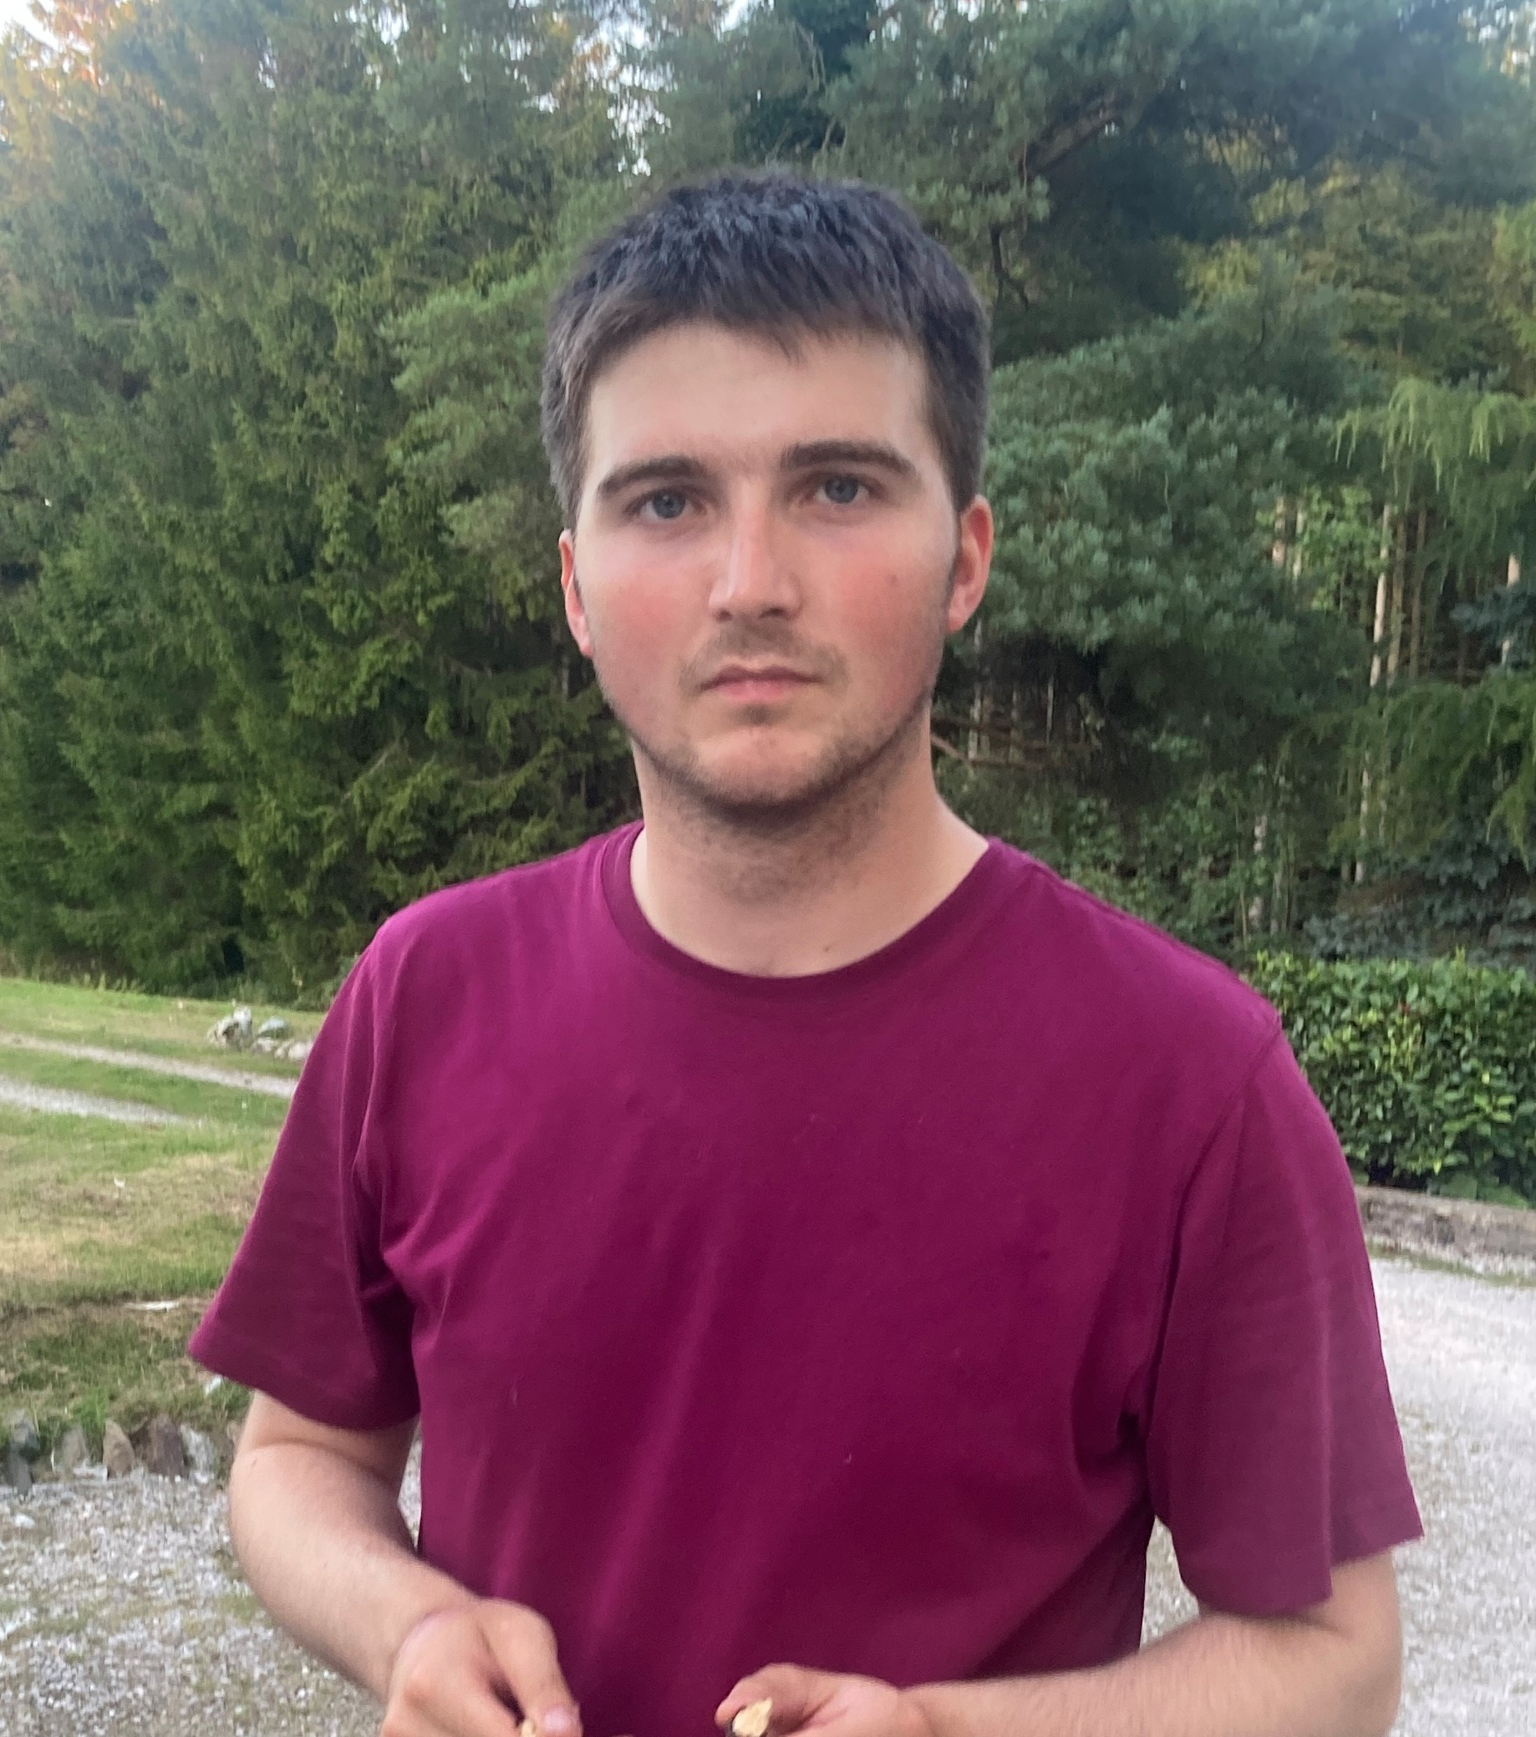
Navigating New Horizons: Daniel’s Journey into Supported Living Gorwelion Newydd: Taith Daniel i Byw Bywyd Anibynnol
Eli Evans – PBS and Active Support Mentor Cyngor Gwynedd – Mentor Cefnogaeth Weithgar ag Ymddygiad Cadarnhaol
Mathew Hopson - PBS and Active Support Mentor Cyngor Gwynedd – Mentor Cefnogaeth Weithgar ag Ymddygiad Cadarnhaol
Shanna McCormick – Support Service Practice Leader – Arweinydd Gwasanaeth Cefnogol

Slide 2
Our Team Tîm Ni
Tîm bach yn gweithio i Gyngor Gwynedd.
Rydym yn gweithio gyda gwasanaethau cefnogol er mwyn neud yn sicr bod PBS a Chefnogaeth Gweithgar yng nghanol bob gwasanaeth, a bod nhw yn deall faint mor bwysig yw’r ddau fodel yma.
Nod mwyaf pwysig y tîm yw cynyddu ansawdd bywyd yr unigolion sy’n defnyddio’r gwasanaethau.
Rydym yn treulio amser gyda’r arweinyddion gwasanaeth a chadw nhw yn rhan o’r broses.
Rydym yn ffocysu ar “Tier 1 Strategies” or fframwaith PBS.
Dydi’r arbenigwyr ddim yn arwain y broses yma, ond yn gweithio gyda’r tîm a’r MDT.
We are a small team working for Gwynedd Council.
We strive to embed PBS values and the Active Support by changing the culture and environments provided for staff and service users.
Our focus is to increase the quality of life of people using services.
Invest in practice leaders and involve them in the process
Focus on Tier 1 strategies of the PBS framework, known as “universal for all”.
Not expert lead. We work in partnership with the team and other stakeholders.

Slide 3
Background Cefndir
Daniel is a 22-year-old man.
He is a kind and happy young man who is always keen to please others.
Daniel lived at home with his 2 younger brothers and parents who both work for the NHS.
Daniel attends day services 5 days a week and used to go to local respite service.
Daniel thrives on structure, routines and predictability.
Daniel was ready to transition from his family home into supported living.
Mae Daniel yn 22 blwydd oed.
Mae o yn berson caredig a hapus a mae o wrth ei fodd yn neud bobl eraill yn hapus.
Mi oedd Daniel yn byw adref gyda’i 2 brawd bach a Mam a Dad sydd yn gweithio i’r GIG.
Mae Daniel yn mynychu gwasanaeth dydd 5 diwrnod yr wythnos.
Mae Daniel wrth ei fodd gyda threfn, cysondeb a strwythur.
Oedd Daniel yn barod i symud allan o’i gartref teulu i fyw bywyd annibynnol.

Slide 4
Our Goals Ein Nod
We were asked to do some work with Daniel to make the transition into his new home as smooth as possible.
To identify areas where we could improve his quality of life.
Produce a plan in co-production with other stakeholders for new staff team members to get to know Daniel and create a capable environment for him in his new home
Work in partnership with the new staff team and practice leader to share information about Daniel and the PBS framework and Active Support model.
Wnaeth yr MDT gofyn am gefnogaeth i help gyda’r broses o symud Daniel allan o’i gartref teulu i fewn i’w tŷ ei hyn.
Ffeindio llefydd lle oedd yna sgôp i gynyddu ansawdd bywyd Daniel.
Cynhyrchu cynllun mewn partneriaeth gyda phawb ym mywyd Daniel er mwyn i’r tîm staff dod i nabod Daniel a chreu amgylchedd galluog iddo.
Gweithio mewn partneriaeth gyda’r tîm o staff ag arweinydd gwasanaeth i rhannu gwybodaeth am Daniel, y fframwaith PBS a’r model cefnogaeth weithgar.

Slide 5
Training and Coaching Mentora ac Hyfforddiant
PBS Awareness Training.
Co-delivered communication training specific to Daniel’s needs with his Speech and Language Therapist.
Spent time sharing knowledge with the Practice Leader and investing time upskilling and building her confidence to coach and mentor the staff.
Active Support Training following the 3-stage training model. This included Active Support theory, role play and in-vivo observations.
Ymwybyddiaeth PBS
Hyfforddiant cyfathrebu yn benodol i anghenion Daniel – mewn partneriaeth gyda Therapydd Iaith a Lleferydd.
Rhannu gwybodaeth gyda’r arweinydd gwasanaeth a threulio amser yn adeiladu ei hyder i fentora’r staff.
Hyfforddiant Cefnogaeth Weithgar Rhyngweithiol yn dilyn “3 stage training model”.

Slide 6
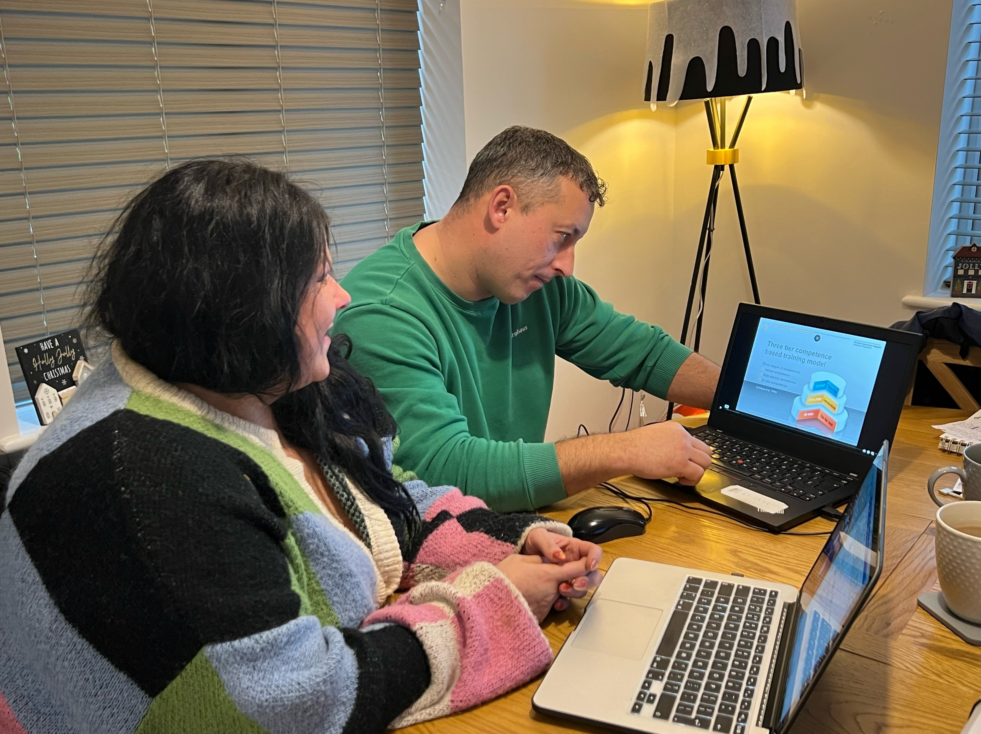
Mathew sharing knowledge about the 3-stage training model.
Mathew yn rhannu gwybodaeth am y “3-stage training model”.

Slide 10
Active Support Participation Measure (Jones and Lowe, 2018) November 2023

Slide 11
Daniel’s Life Now Bywyd Daniel Rwan
Daniel has now settled in his new home.
He still attends day services 5 days a week and visits his family home at weekends.
Daniel has a visual timetable which has been implemented by Speech and Language Therapist, this has been very successful.
Daniel is an active participant in his life and improving daily living skills.
Daniel is building a good rapport with his support staff and co-tenants.
Continues to maintain good relationship with other friends and family.
Mae Daniel yn hapus yn eu cartref Newydd erbyn hyn.
Mae Daniel dal i fynychu gwasanaeth dydd 5 diwrnod yr wythnos.
Mae gen i Daniel amserlen weledol sydd wedi cael ei greu gan y therapydd iaith a lleferydd.
Mae Daniel yn bartner actif yn ei bywyd ei hun ag yn gweithio ar ei sgiliau byw bob dydd.
Mae Daniel wedi dechrau perthynas da gyda’r holl staff a’r dynion eraill yn y tŷ.
Mae Daniel i weld teulu a ffrindiau eraill yn aml.

Slide 12
Active Support Participation Measure (Jones and Lowe, 2018) January 2024

Slide 13
Active Support Participation Measure (Jones and Lowe, 2018) Comparison Cymhariaeth
Task Category | Frequency Score November 2023 | Frequency Score January 2024
Food and Drink Preparation | 13 | 17
Personal Care | 35 | 35
General household Tasks | 14 | 29
Laundry | 13 | 18
Use of Other Household Equipment | 12 | 24
Shopping | 8 | 13
Community Activities | 6 | 22
Hobbies/Leisure | 11 | 26
Vocational Activities | 6 | 9
TOTAL SCORE | 118 | 193

Slide 14
Moving Forward Symud Ymlaen
We are now getting to know Daniel much better.
We are continuing to learn what works for Daniel and how to build a capable environment for him.
We hope to continue to improve Daniel’s participation in Active Support and work on his daily living skills.
We hope to provide more opportunities for Daniel to engage in meaningful activities.
Further improve quality of life.
I am confident to role model good practice to the staff and pass on my knowledge and skills to them
Rydym wan yn dod i nabod Daniel yn llawer gwell.
Dal i ddysgu am y ffordd gorau i’w cefnogi a sut mae amgylchedd galluog yn edrych iddo fo.
Rydyn yn gobeithio i dal i weithio ar faint mae Daniel yn cymryd rhan mewn cefnogaeth weithgar a gweithio ar eu sgiliau byw.
Rydym yn gobeithio ffeindio mwy o gyfleoedd i Daniel cymryd rhan mewn gweithgareddau ystyriol.
Cynyddu ansawdd bywyd mwy eto.
Dwi wan yn hyderus i fodelu ymarfer Gwaith da i’r staff a rhannu fy sgiliau gyda’r tîm.

Slide 16
Contact Cyswllt
ElinorEvans@gwynedd.llyw.cymru
MathewOwenHopson@gwynedd.llyw.cymru

