Slide 1
What I think when I talk about PBS
Beth rydw i’n ei feddwl wrth siarad am CYC
Tony Osgood,
January 2024
tonyosgood@protonmail.com

Slide 2
1
“An institution is not just a place, it is some kind of mental category that aﬀects perceptions and interaction
rules”
(p.77, Tøssbro, 1996)
Notes:
2. Being person centred isn’t another job, it is the job; this idea feels uncomfortable when you first encounter it having worked for a while in education or health or social care… where you work is not a blank canvas, but a space with existing cultures
3. So what I think about when I talk about PBS is: please don’t let service land ruin PBS as it did normalisation!

Slide 3
Who the hell does he think he is?
Pwy mae’n feddwl yw e?
Uwch Ddarlithydd wedi ymddeol yn gynnar yn y maes Anableddau Deallus yng Nghanolfan Tizard, wedi gweithio yn y meysydd seicoleg, gwasanaethau uniongyrchol a gofalwr i’r teulu hefyd
Ymgynghorydd/awdur/mentor/goruchwyliwr Annibynnol
Golygydd ar y cyd, a chyfrannwr i Understanding & Responding to Behaviour (2019, Pavilion)
Supporting Positive Behaviour (2020, JKP) (ISBN 9781787751323)
Practice Leadership in Challenging Behaviour Services (March, 2022, JKP) (ISBN 9781839971006)
Services (March, 2022, JKP) (ISBN 9781839971006) Early retired Senior Lecturer in Intellectual Disabilities at Tizard Centre, worked in psychology, direct services, family carer
Independent consultant/writer/mentor/supervisor
Co-editor & contributor to Understanding & Responding to Behaviour (2019, Pavilion)
Supporting Positive Behaviour (2020, JKP) (ISBN 9781787751323)
Practice Leadership in Challenging Behaviour
“The sine qua non of PBS is its focus on assisting individuals to achieve comprehensive lifestyle change with a view to improving quality of life, not only for persons with disabilities but also for those who support them”
(Carr, et al. 2002, p.7)
Notes:
4. Positive Behaviour Support is now translated into Norwegian and Czech, and a lot of my teaching, consultation, supervision & mentoring work happens abroad
5. PBS looks at whole environments - because it is based on eco-behaviour models

Slide 4
if positive behaviour support simply encourages you to measure behaviour, and not get a sense of who the person is, what they need, how is it any more humane than what has not worked before?
Notes:
6. Goodhart’s law: ‘when a measure becomes a target, it ceases to be a good measure’
[‘they were fined for missing the standard rather than bad service’]
Campbell’s law: ‘the more any quantitative social indicator is used for decisions, the more it becomes prone to corruption’
[‘success is the availability of person-centred plans, so we measure how many plan have been reported, not quality or method, so we work to make plans available to prove we’re doing a good job’]
McNamara Fallacy: ‘decision-making based on quantitative observations’ [numbers, not people: we measure what is easiest, we disregard as unimportant what is hard to measure, because our performance is measured by producing easy data]
Example - competitive admissions: quantitative metrics achieved to get on to courses, ignore non-quantifiable, when ultimately non-quantifiable attributes more relevant

Slide 5
Prevent, Teach, Reinforce
avoid/amend predictors (establishing operations and antecedents) teach replacement or competing behaviour
reinforce differentially
Atal, Dysgu, Atgyfnerthu
osgoi/diwygio pethau i ragweld (sefydlu gweithredoedd a phethau blaenorol) dysgu ymddygiad i ddisodli neu gystadlu
atgyfnerthu’n wahanredol
7
Weithiau, mae’n eithaf amlwg gweld os yw rhywun yn cael eu hanwybyddu, yn unig, neu wedi diflasu. Ceisiwch weld y pethau amlwg (‘yr eleffantod’) y mae pobl eraill yn eu hanwybyddu. Bydd eleffantod yn gwasgu’r enaid allan o bobl
Nid oes angen asesiad gweithredol arnoch mwyach i drefnu’r sefyllfaoedd cyffredin hyn nag sydd angen taniad thermoniwclear i
gael tegwch
Cyn estyn am ddadansoddiad gweithredol, neu bresgripsiynau, neu ymyrraethau technolegol deniadol, cyn i chi roi bai ar yr unigolyn, ystyriwch a oes gan yr unigolyn yr ydych yno i’w cefnogi
fywyd da
Ydyn nhw’n ddiogel, hapus?
Ydyn nhw’n cael eu caru?
Ydyn nhw’n byw y bywyd sydd ei angen arnynt
Sometimes, it’s pretty obvious to see if someone is ignored, lonely, or bored. Try to see the obvious things (‘the elephants’) other people are ignoring. Elephants will squeeze the life out of people
You no more need a functional assessment to sort these all too common situations than you do a thermonuclear detonation to
get a level playing ﬁeld
Before reaching for functional analysis, or prescriptions, or technologically enticing interventions, before you blame the person, work out whether the person you’re there to support has
got a good life
Are they secure, happy? Are they loved? Are they living the life they need?
8
Notes:
7. PBS in one slide (the science bit)
8. The best PBS practitioners are good scientists with person-centred values. The worst PBS practitioners are technically proficient but do not listen to others.

Slide 6
The Elephants in the Room
Yr Eleffantod yn yr ystafell
9
Health
Family & Friends
Iechyd
Teulu a Ffrindiau
Service competency Person-centred planning
An interesting and active life
Belonging Time for the person
Communication Rapport
Happiness
Cymhwysedd gwasanaeth
Cynllunio sy’n canolbwyntio ar yr unigolyn
Bywyd diddorol ac egniol
Perthyn Amser i’r
Unigolyn Cyfathrebu Perthynas
Hapusrwydd
10
If the behaviour guy says I have to earn soda rather than just have it in the fridge that’s what happens. If the legalised drug dealer says that I should take this pill then that is what will happen
If I spit it out it will be buried in my ice cream. That is, if I’m allowed ice cream and haven’t
been put on a diet by a bunch of overweight suits calling themselves the team
-John Clements & Neil Martin, 2002
11
Person-centredness - less assessment, more ally
Don’t begin with what is ‘wrong’, begin with who the person is and wishes to be
Build support around the preferences of the person (get off their case, get on their side)
What is a good day for the person?
What do they hope from the future?
Would someone who loves the person recognise them from your notes?
Canolbwyntio ar yr unigolyn - llai o asesiad, mwy o gynghreirio
Peidiwch â dechrau efo beth sy’n ‘anghywir’, dechreuwch gyda phwy yw’r unigolyn a phwy maent yn dymuno bod
Adeiladwch gefnogaeth o amgylch dewisiadau yr unigolyn (peidio cwyno, bod ar eu hochr nhw)
Beth yw diwrnod da ar gyfer yr unigolyn? Beth yw eu dyheadau ar gyer y dyfodol? A fyddai rhywun sy’n caru’r unigolyn eu hadnabod
Notes:
9. Before reaching for a functional assessment consider removing the elephants in the room… think about the person’s health, their relationships, how they spend their time… and the mother of all elephants: happiness
10. So what I think about when I talk about PBS is: please don’t let service land ruin PBS as it did The Five Accomplishments - dignity & respect, choice, community presence, community participation, competence - indicators of an adult quality of life
11. Compare to this referrals - you cite what is wrong. Medical model underpins referrals - meet criteria, open, treat, close. PBS works well when delivered through long-term relationships

Slide 7
Suit you, sir?
Does a person ‘have’ challenging behaviour?
Behaviours are by and large inﬂuenced by the environment – and learned
Eich siwtio chi?
Oes gan yr unigolyn ymddygiad heriol?
Mae ymddygiadau yn bennaf yn cael eu dylanwadu gan yr amgylchedd - a’u dysgu
12
13
Prevent, Teach, Reinforce
avoid/amend predictors (establishing operations and antecedents) teach replacement or completing behaviour
reinforce differentially
Atal, Dysgu, Atgyfnerthu
osgoi/diwygio pethau i ragweld (sefydlu gweithredoedd a phethau blaenorol) dysgu ymddygoad i ddisodli neu gystadlu
atgyfnerthu’n wahanredol
14
PBS strives to be functional, constructional and socially valid
Intervention is related to identiﬁed functional relationships between the behaviour and antecedents, consequences etc
Mae CYC yn ymgeisio i fod yn weithredol, yn adeiladol ac yn ddilys yn gymdeithasol
Mae ymyrraeth yn berthnasol i berthnasau gweithredol a nodwyd rhwng yr ymddygiad, pethau blaenorol, canlyniadau, ac ati
Notes:
12. If you want to see change in the person, change how you are, change how you respond
13. All of this person-centredness can be considered antecedent interventions - get the life right. Then many behaviours stop. If you think behaviours that challenge as complaining, you address the complaint early on - up-stream solutions
14. If you don’t know the function of the specific behaviour then any intervention can inadvertently increase the behaviour by bootleg reinforcement

Slide 8
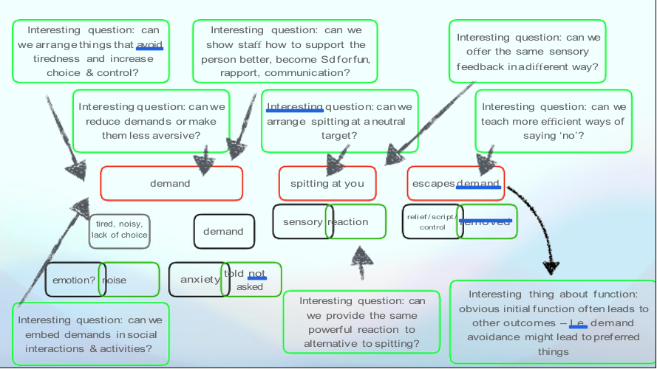
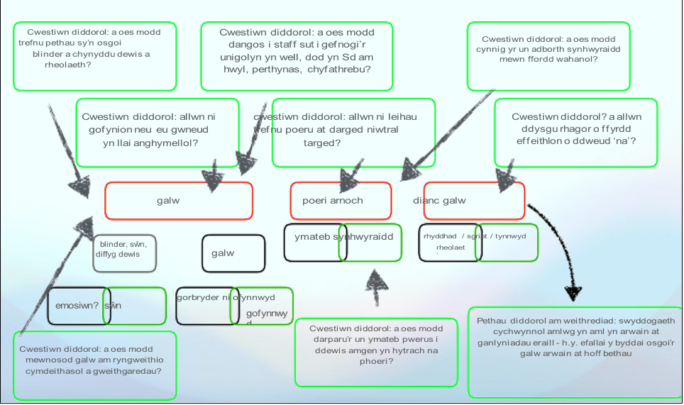
15
16
17
Good support plans make the behaviours that challenge ‘obsolete’ by teaching alternative, competing behaviours that are more efficient at achieving the same function (functional equivalence)
Antecedent interventions – don’t have to be contingently reinforcing
Mae cynlluniau cefnogi da yn darfod yr ymddygiadau sy’n herio, drwy ddysgu dewis amgen, ymddygiadau sy’n cystadlu yn fwy effeithlon o ran cyflawni’r un swyddogaeth (cywerthedd gweithredol)
Ymyrraeth rhagflaenol - nid oes rhaid bod yn atgyfnerthu at raid
Notes:
15. Three-term contingency - ABC charts - only of use if regularly reviewed. We shouldn’t collect ABC data all the time. The method was designed to be a probe not a monitoring device
16. Examples of what we can do when we know why a behaviour is happening… person-centred formulation

Slide 9
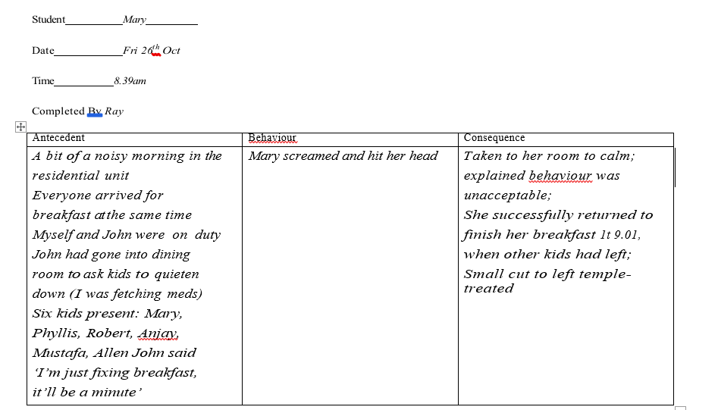
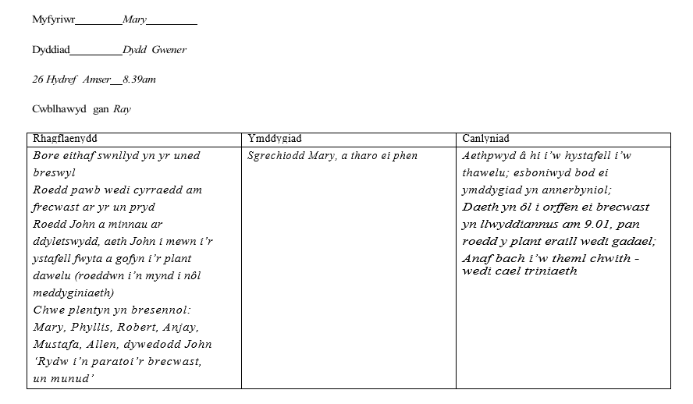
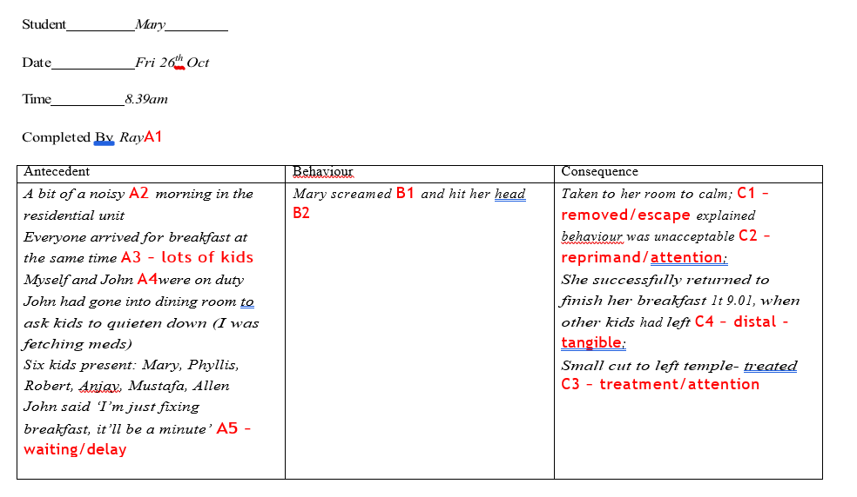
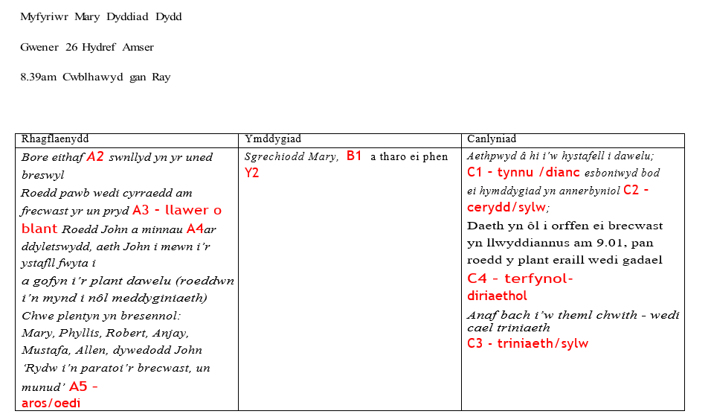
18
19
20
Notes:
18. How we might analyse ABC records - example
19. Code the antecedents, the behaviours, the consequences. When we analyse these, we do it by looking for common antecedents and consequences to screaming, then the same with hitting head, then the same with hitting staﬀ etc (whilst it may be unprofessional, sometimes people hit staﬀ because staﬀ behave like arseholes - code what is seen and reported regardless of ‘being nice’)
20. A coded ABC chart

Slide 10
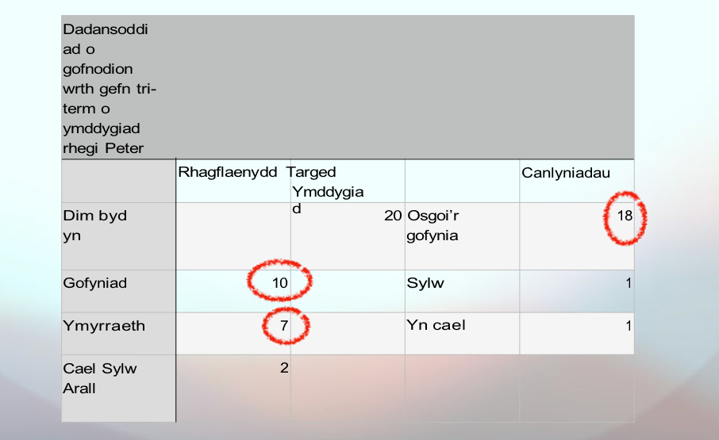
21
22
23
Notes:
21. You list the antecedents and consequences for each behaviour, then total them…
22. And write a summary label - you then have three dimensions where you can come up with interventions….
23. Reminders…

Slide 11
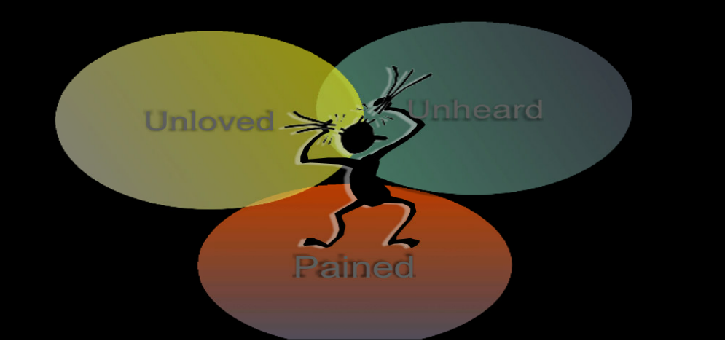
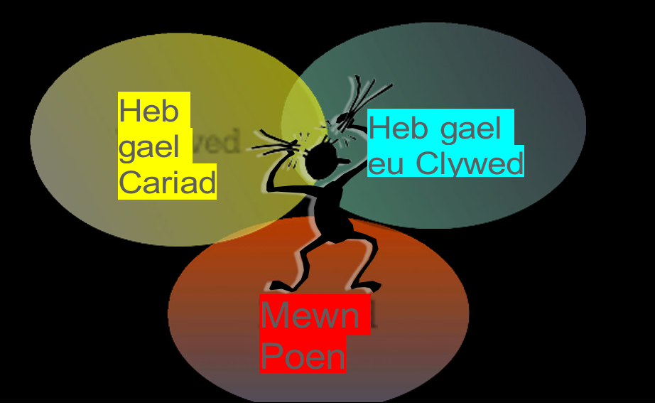
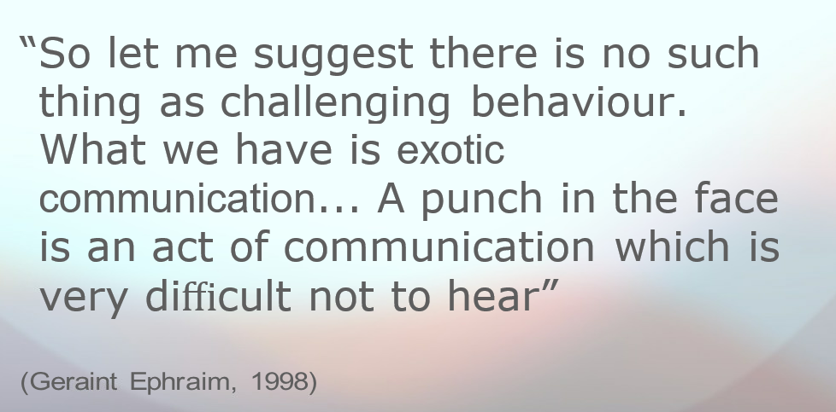
24
25
26
Notes:
25. The problem with measuring people without qualitative factors
26. Behaviours that challenge are not abnormal… self-determination? Self- expression? Self-harm as coping, as language

Slide 12
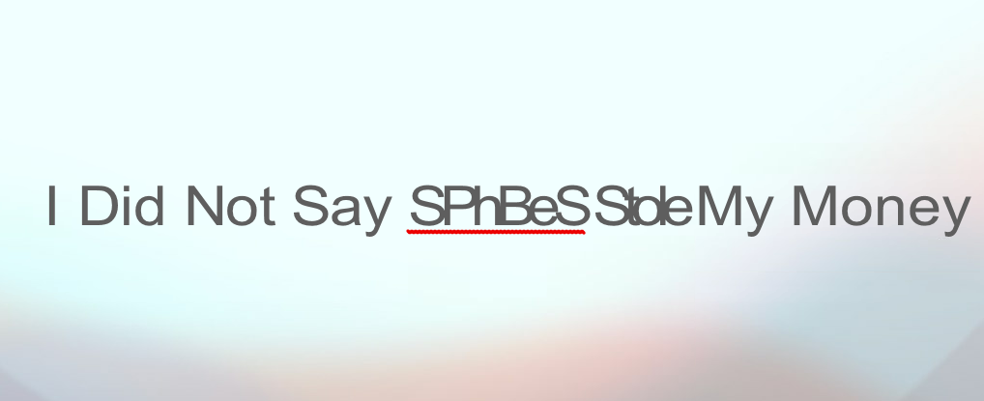
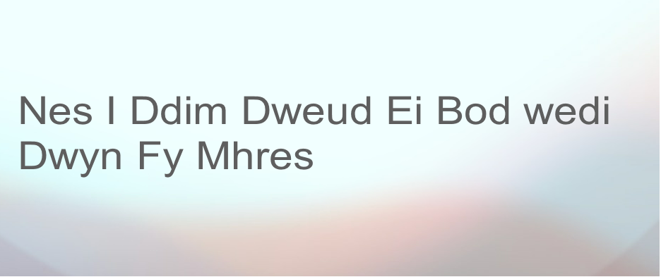
27
28
Notes:
27. “New names and phrases always run the risk of becoming spiffy euphemisms for ‘business as usual’”
28.
It’s not pbs if people focus on values more than science It’s not pbs if people focus on science more than values It’s not pbs if restrictive or punishing interventions are used
It’s not pbs if the person or support circle has no involvement in the exploration, plan or evaluation
It’s not pbs if there’s no plan to skill-up the people around them

Slide 13
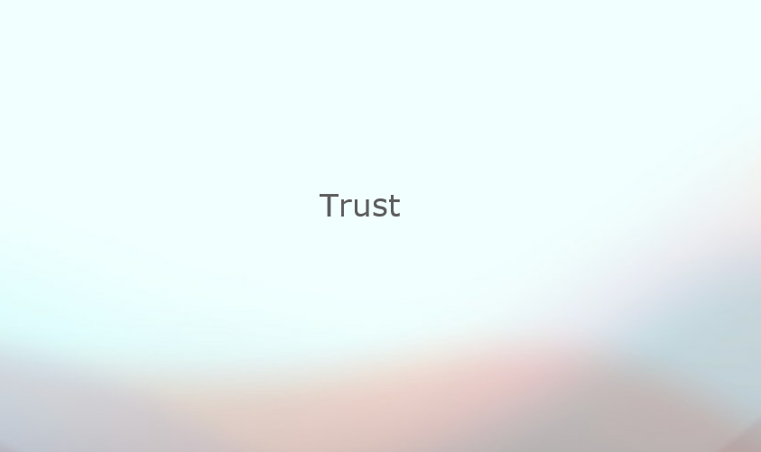
29
30
31
Notes:
29. So what I think about when I talk about PBS is: please don’t let service land ruin PBS as it did Valuing People and person-centred planning!
30. Who knows?
How many do you trust? Pitonyak - agency

Slide 14
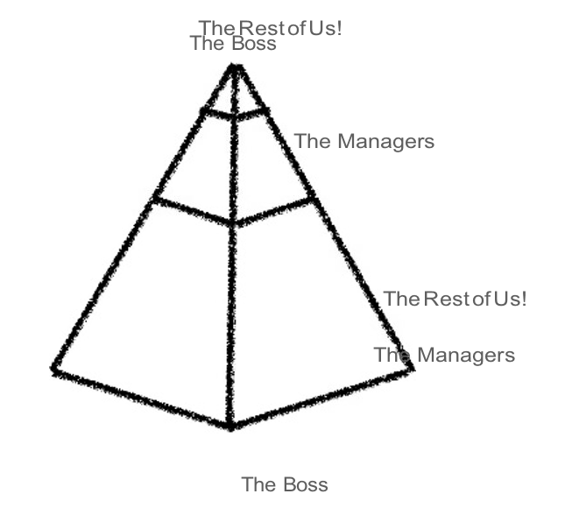
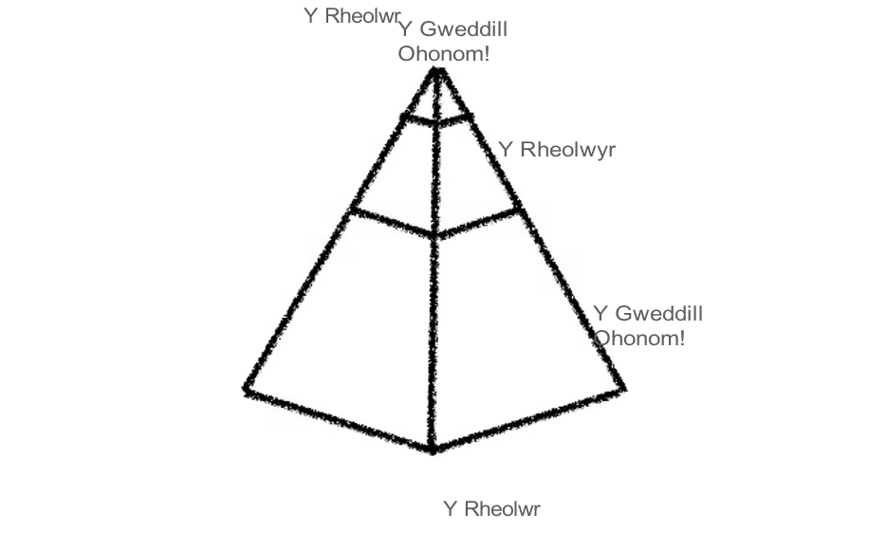
32
33
34
Notes:
32. Ancient wisdom
33. Serviceland
34. Serviceland

Slide 15
35
36
Notes:
35. Maori aphorism (Aotearoa):
What is most important in this world? It is people, it is people, it is people. Organisations enable PBS and person-centredness, but it is carried out by people. A leader blaming staﬀ is a poor leader.
36. You know people say Goldfish grow only as big as their tanks? What if that’s us. People with IDD. Professionals. All of us?
Think about people living in Serviceland. Think of our expectations of them. Think of what our training teaches us to see, to presume, to forget. We can forget the person.
What does someone leave behind when they enter serviceland?

Slide 16
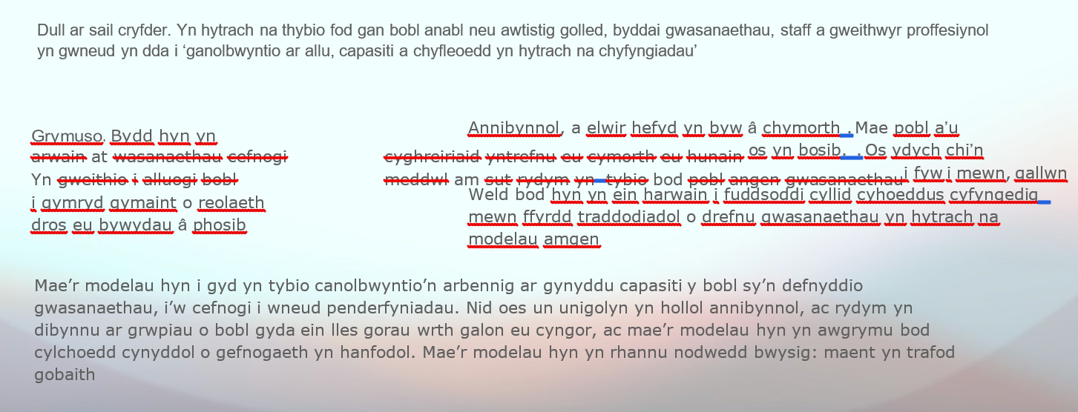
37
38
39
Notes:
37. Theoretical models
38. So what I think about when I talk about PBS is: please don’t let service land ruin PBS as it did personalisation, like it has community support!
39. You might be the only one listening to the person; among your colleagues this will make you as popular as a fart in a spacesuit

Slide 17
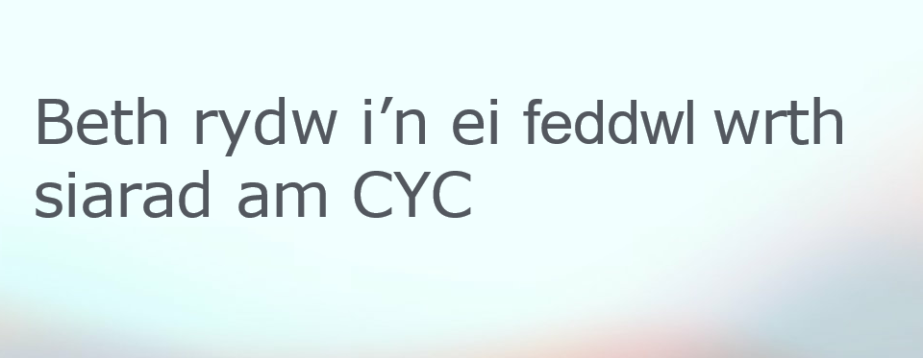
40
41
42
Notes:
40. Learn to listen
41 It isn’t hard to grow rapport. But we’re making a promise to the person when we listen. Being with a person is often diﬀerent from working with them. There should be workshops about rapport building as much as PBS

