Slide 1
North Wales Positive Behavioural Support (PBS) Implementation Strategy
Strategaeth Gweithredu Cefnogaeth Ymddygiad Cadarnhaol (CYC) Gogledd Cymru
Jonathan Crabb
North Wales PBS Specialist Lead / Arweinydd Arbenigol CYC Gogledd Cymru
North Wales Together / Gogledd Cymru Gyda’n Gilydd
Inaugural North Wales CoP / Cymuned Ymarfer Gogledd Cymru Agoriadol
January 31st 2024 / 31 Ionawr 2024

Slide 3
Gwybodaeth ymarferol Housekeeping
Introductions
Toilets
Lunch and breaks
Timekeeping
Fire exits
Mobile phones
Respecting and valuing each other
Cyflwyniadau
Toiledau
Cinio ac egwyl
Cadw amser
Allanfeydd tân
Ffonau symudol
Parchu a gwerthfawrogi ein gilydd

Slide 4
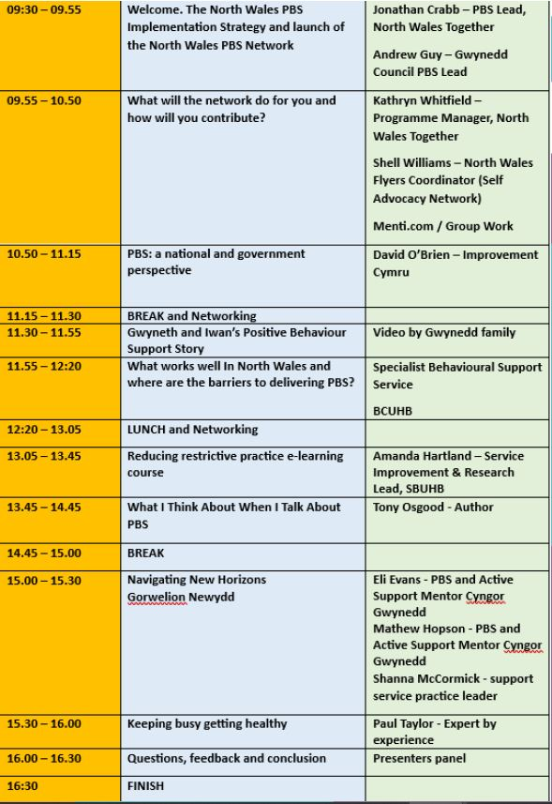

Slide 6
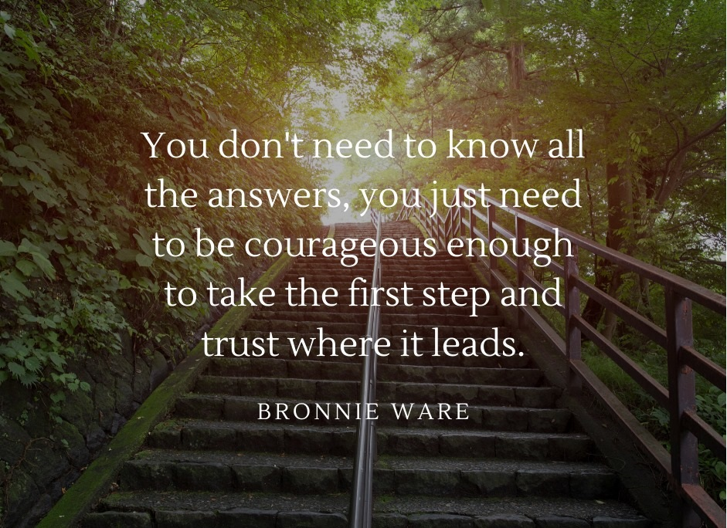

Slide 7
Fideo 7 munud ‘Cyflwyniad i CYC’ gan BILD i’w weld yma:
A 7 minute ‘Introduction to PBS’ video from BILD can be seen here: https://youtu.be/epjud2Of610

Slide 8
Nod Goal
To increase the prevalence and quality of good PBS within North Wales
What do you think is meant by the term ‘good PBS’?
Cynyddu cyffredinolrwydd ac ansawdd CYC da yng Ngogledd Cymru
Beth ydych chi’n ei gredu a olygir gan y term ‘CYC da’?

Slide 9
Sefydlu gweithgor Gogledd Cymru yn cynnwys arbenigwyr ac anogwyr CYC:
Establish a North Wales working group consisting of PBS experts and drivers:
Carrie Shield – Complex Needs Service Manager (BCUHB)
Dr Alan Dowey - Consultant Clinical Psychologist / Head of Adult Clinical Psychology (Learning Disabilities) (BCUHB)
Andrew Guy – PBS Lead, Gwynedd County Council
David O’Brien - Senior Improvement Manager, Improvement Cymru
Alison Heaton - Planning and Development Officer, North Wales Together
Dr Jason Devereux – Advanced Nurse Practitioner in PBS (BCUHB)
Emma Edwards – Community Support Coordinator, Conwy Council
Heather Henry – Project Team Manager, Wrexham Council
Jo Price – Education & Development Lead – BILD
Awaiting confirmation of expert by experience
Jonathan Crabb – PBS Specialist Lead, North Wales Together
Carrie Shield – Rheolwr Gwasanaeth Anghenion Cymhleth (Bwrdd Iechyd Prifysgol Betsi Cadwaladr)
Dr Alan Dowey - Seicolegydd Clinigol Ymgynghorol / Pennaeth Seicolegydd Clinigol Oedolion (Anableddau Dysgu) (BIPBC)
Andrew Guy - Arweinydd CYC, Cyngor Sir Gwynedd
David O’Brien - Uwch Reolwr Gwelliant, Gwelliant Cymru
Alison Heaton - Swyddog Cynllunio a Datblygu, Gogledd Cymru Gyda’n Gilydd
Dr Jason Devereux - Uwch Ymarferydd Nyrsio mewn CYC (BIPBC)
Emma Edwards – Cydlynydd Cefnogaeth Gymunedol, Cyngor Conwy
Heather Henry - Rheolwr Tîm Prosiect, Cyngor Wrecsam
Jo Price - Arweinydd Addysg a Datblygiad - BILD
Aros am gadarnhad o arbenigwr yn ôl profiad
Jonathan Crabb - Arweinydd Arbenigol CYC, Gogledd Cymru Gyda’i Gilydd

Slide 10
Swyddogaeth y grŵp
Role of group
To articulate a vision of how we can increase the prevalence and enhance the quality of PBS within North Wales.
To establish how we can gain maximum impact, from within the scope of the budget, timescale and our capacity.
To provide support to implement this vision
I greu gweledigaeth o sut y gallwn gynyddu cyffredinolrwydd a gwella ansawdd CYC yng Ngogledd Cymru.
I sefydlu sut y gallwn gael yr effaith fwyaf, o fewn cwmpas y gyllideb, amserlen a’n gallu.
I ddarparu cefnogaeth i weithredu’r weledigaeth hon

Slide 11
Gweithio mewn Partneriaeth Partnership Working
The importance of partnership working and value of inclusion
Need for input around what is needed and how this could be achieved
Importance of inclusion from individuals who are receiving or may benefit from PBS
Establishment of a representative structure to support engagement
Group evolving to have county based representation. Seeking a volunteer to represent and liaise with Flintshire, Denbighshire and Anglesey
Pwysigrwydd gwaith partneriaeth a gwerth cynhwysiant
Angen cyfraniad o ran beth sydd ei angen a sut y gellir cyflawni hyn
Pwysigrwydd cynhwysiant gan unigolion sy'n cael neu a allai elwa o CYC
Sefydlu strwythur cynrychioladol i gefnogi ymgysylltiad
Y grŵp yn esblygu i gael cynrychiolaeth sirol. Edrych am wirfoddolwr i gynrychioli a thrafod gyda Sir y Fflint, Sir Ddinbych ac Ynys Môn

Slide 12
Method
Diffinio’r grŵp targed yn weithredol
Operationally define target group:
Individuals diagnosed with learning disabilities in North Wales
Focus mainly on implementation with adults then progress with increasing focus on children in year two
Unigolion sydd â diagnosis o anableddau dysgu yng Ngogledd Cymru
Canolbwyntio’n bennaf ar weithredu gydag oedolion yna symud i ganolbwyntio’n gynyddol ar blant ym mlwyddyn 2

Slide 13
Dull / Method
Sut fyddwn yn gwybod ein bod yn gwneud gwahaniaeth?
How will we know what we do makes a difference?
Undertake simple benchmarking exercise through questionnaire to explore how many providers are using PBS, with what level of staff training
Repeat measure annually to explore difference
Please complete the survey here:
English version of the survey: https://www.surveymonkey.co.uk/r/PBSenglish
Welsh version of the survey: https://www.surveymonkey.co.uk/r/PBScymraeg
Cynnal ymarfer meincnodi syml trwy holiadur i ganfod faint o ddarparwyr sy’n defnyddio CYC, gyda pha lefel o hyfforddiant staff.
Ailadrodd y mesur yn flynyddol i edrych ar y gwahaniaeth
Cwblhewch yr arolwg yma os gwelwch yn dda:
Fersiwn Saesneg o’r arolwg: https://www.surveymonkey.co.uk/r/PBSenglish
Fersiwn Gymraeg o’r arolwg: https://www.surveymonkey.co.uk/r/PBScymraeg

Slide 14
Nodau o ran dull Method aims
Promote awareness of PBS and its worth and benefits
Promote and support access to information and training
Support the development of Practice Leadership
Develop a network of PBS practitioners
Hyrwyddo ymwybyddiaeth o CYC, ei werth a’i fanteision
Hyrwyddo a chefnogi mynediad at wybodaeth a hyfforddiant
Cefnogi datblygiad Arweinyddiaeth Ymarfer
Datblygu rhwydwaith o ymarferwyr CYC

Slide 15
Dull - Hyrwyddo ymwybyddiaeth o CYC da, ei werth a’i fanteision Method - Promote awareness of PBS and its worth and benefits
Establish system of communication to enable access to key information to inform and signpost people as to how to implement a quality PBS approach.
Develop PBS leaflet that provides brief explanation of what good PBS looks like and explains its context within North Wales Services, signposts people to key information, access to training, funding and local champions.
Develop easy read version of the above
Develop website / Social Media pages
Sefydlu system o gyfathrebu i alluogi mynediad at wybodaeth allweddol i hysbysu a chyfeirio pobl o ran sut i weithredu dull CYC o safon.
Datblygu taflen CYC sy’n rhoi eglurhad cryno o beth yw CYC da ac egluro ei gyd-destun o fewn Gwasanaethau Gogledd Cymru, cyfeirio pobl at wybodaeth allweddol, mynediad at hyfforddiant, cyllid a phencampwyr lleol
Datblygu fersiwn hawdd ei ddarllen o’r uchod
Datblygu gwefan / tudalennau cyfryngau cymdeithasol

Slide 17
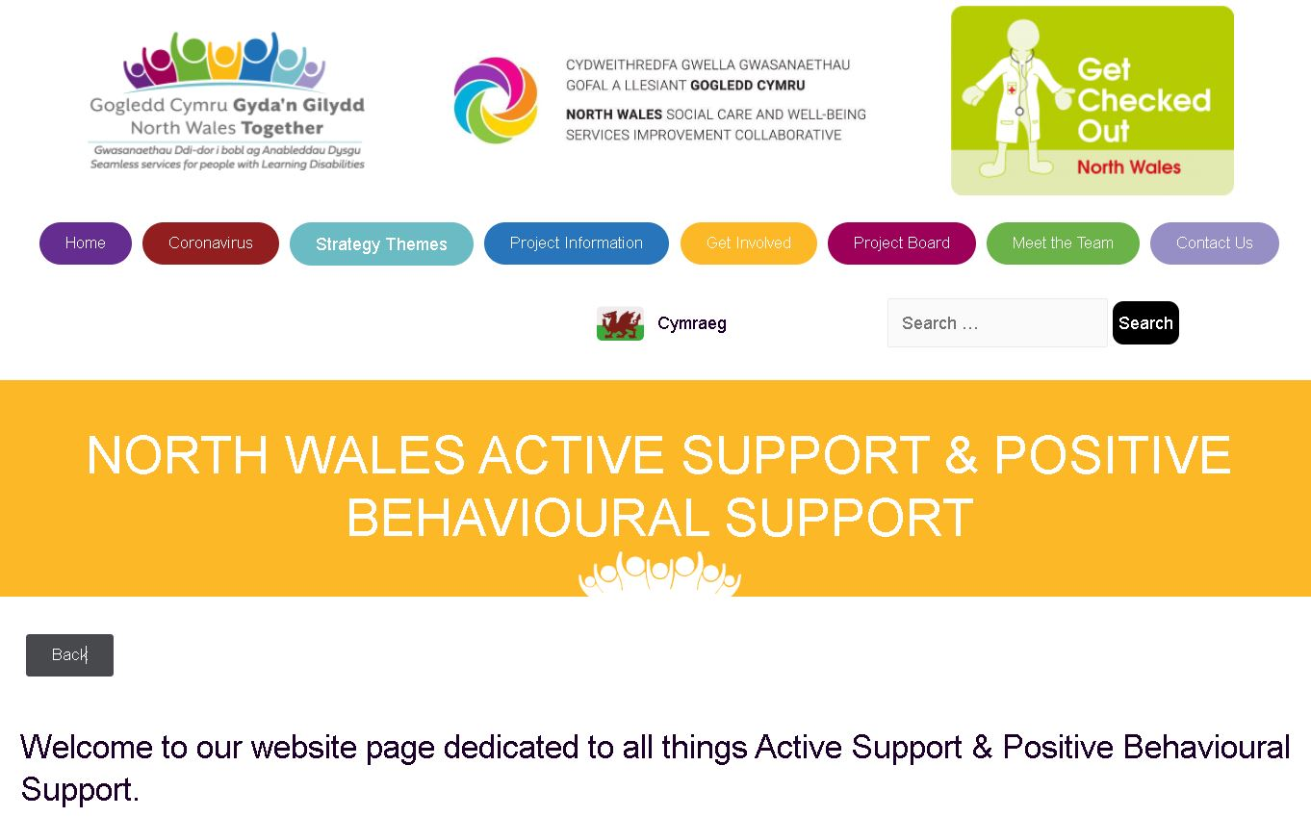
https://northwalestogether.org/active-support/

Slide 18
https://northwalestogether.org/active-support/

Slide 19
Dull - mynediad at hyfforddiant Method - Access training
Provide information:
Inform who, working at what level would benefit from which training (e.g. PBS Competence Framework)
Specifying course level, duration and cost
Grants available to support this
Value will be recognised in applications focused on longevity, particularly a ‘train the trainers’ approach
Darparu gwybodaeth:
Hysbysu pwy, yn gweithio ar ba lefel fyddai’n elwa o ba hyfforddiant (e.e. Fframwaith Cymhwysedd CYC)
Nodi lefel, hyd a chost y cwrs
Grantiau ar gael i gefnogi hyn
Bydd gwerth yn cael ei gydnabod mewn ceisiadau sy’n canolbwyntio ar hirhoedledd, yn arbennig dull ‘hyfforddi’r hyfforddwyr’

Slide 20
Dull - Arweinyddiaeth Ymarfer Method - Practice Leadership
Provide information and support to organisations to help articulate a staffing structure that details PBS expertise and support being available throughout the whole structure (including Managers)
Develop a network of PBS practitioners
Darparu gwybodaeth a chefnogaeth i sefydliadau i helpu i greu strwythur staffio sy’n nodi fod arbenigedd a chefnogaeth CYC ar gael trwy’r strwythur cyfan (gan gynnwys Rheolwyr)
Datblygu rhwydwaith o ymarferwyr CYC

Slide 22
CYC a Chymuned Ymarfer Cefnogaeth Weithredol Gogledd Cymru. North Wales PBS and Active Support Community of Practice
Two CoPs a year (January 31st and October 10th, 2024)
Will build on previous successes from Active Support CoPs
Alternating face to face and online events
North Wales Practitioners will be prioritised for places
Dwy Gymuned Ymarfer y flwyddyn (31 Ionawr a 10 Hydref 2024)
Adeiladu ar lwyddiannau blaenorol o Gymunedau Ymarfer Cefnogaeth Ymarferol
Digwyddiadau wyneb yn wyneb ac ar-lein
Bydd Ymarferwyr Gogledd Cymru yn cael eu blaenoriaethu ar gyfer lleoedd

Slide 23
Dull - Rhwydwaith o ymarferwyr CYC Method - Network of PBS practitioners
Establish means whereby North Wales PBS Practitioners can help inform, develop and support each other
Website: https://northwalestogether.org/
Social Media options being developed to support group interaction and share resources
Network to be launched at first PBS + AS CoP January 31st 2024
We have joined the UK PBS Alliance https://www.bild.org.uk/uk-pbs-alliance/
Sefydlu ffordd y gall Ymarferwyr CYC Gogledd Cymru hysbysu, datblygu a chefnogi ei gilydd
Gwefan: https://northwalestogether.org
Opsiynau cyfryngau cymdeithasol yn cael eu datblygu i gefnogi rhyngweithio grŵp a rhannu adnoddau
Rhwydwaith i’w chyhoeddi yn y Gymuned Ymarfer CYC + AS cyntaf ar 31 Ionawr 2024
Rydym wedi ymuno â Chynghrair CYC y DU https://www.bild.org.uk/uk-pbs-alliance

Slide 25
A peer review process for PBS training
Marie Lovell

Slide 26
Cysylltiadau a gwybodaeth bellach Contacts & further information
Marie Lovell marie.lovell@skillsforcare.org.uk
innovation@skillsforcare.org.uk
https://www.skillsforcare.org.uk/Developing-your-workforce/Care-topics/Supporting-people-with-challenging-or-distressed-behaviour/Supporting-people-with-challenging-or-distressed-behaviour.aspx

Slide 27
Eich cyfraniad Your input
How will you inform and engage with your organisation about this?
Consider how a vision of practice leadership can be articulated and implemented within your organisation (a whole systems approach)
If you would kindly cascade the survey within your organisation and support this data to be collated and submitted within a month
We are currently looking to invite input from individuals who are receiving or may benefit from PBS, if you know anyone who may be interested?
Are you interested in applying for any PBS training funding?
But it’s your network, what do you want and what will you do to help?
Sut fyddwch yn hysbysu ac ymgysylltu â’ch sefydliad ynglŷn â hyn?
Ystyriwch sut y gall gweledigaeth o arweinyddiaeth ymarfer gael ei mynegi a’i gweithredu o fewn eich sefydliad (dull system gyfan)
A wnewch chi rannu’r arolwg o fewn eich sefydliad a chefnogi’r data hwn i’w gasglu a’i gyflwyno o fewn mis
Rydym yn gobeithio gwahodd cyfraniad gan unigolion sy’n cael neu a allai elwa o CYC, os ydych yn adnabod unrhyw un a fyddai â diddordeb?
A oes gennych ddiddordeb mewn ymgeisio am unrhyw gyllid hyfforddiant CYC?
Ond eich rhwydwaith chi yw hi, beth ydych chi eisiau a beth fyddwch yn ei wneud i helpu?

