Slide 1
Implementing Active Support across a School, College and Residential environment, measuring the impact for the individual.
Lynne Thompson
Rachel Fleming
Aimee Kitchingman

Slide 2
Individual
Children's service
School
CEO / ELT / Directors
Young peoples service
College
Support Service
Positive Behaviour Support
Notes:
Previous RSD
Now - children/YP – day and residential school / college - with complex and severe learning disabilities which include communication difficulties – 2 ½ years up to 25 years – some children / YP’s with Autism / SLD / Deaf / MSI / wheelchair users / medical needs / high sensory needs / behavior that challenges – 1:1 or 2:1 support / night staff – come from all over the country – difficult to place these YP’s
Day students / short breaks (1 day a week / month) / Monday – Friday / term time and 52 week placements
RSM – 50 students
RCM – 80 students
Children’s – 6 residential and 1 short breaks four bedded houses
YP’s – 9 residential and 1 short breaks
550 staff – approx. – 400 contact and 150 support service
Support service – SALT / OT / Physio's / audiologist / Mental Health nurse / interveners / specialist teachers / assistive technologists
PBS designed specifically for SST – proactive being the focus (both non contact and contact staff)
Person centered programmes / different curriculum / individual timetables - Communication- all sign / visual info / technology

Slide 3
Evidence of Learning
Recording
IEP’s / ILP’s
Pathways to independence – OT
Home / school book
Focus meetings
Annual reviews
Notes:
We had ways to record but Inconsistent recording / no evidence of progress
People said – they can do it / yes they are independent

Slide 4
Pilot
Lead coaches
Five residential children and young people
Trained all staff working with the individual students
Base line
One AS activity
Observations
Notes:
Trained approximately group of lead plus 50 staff

Slide 5
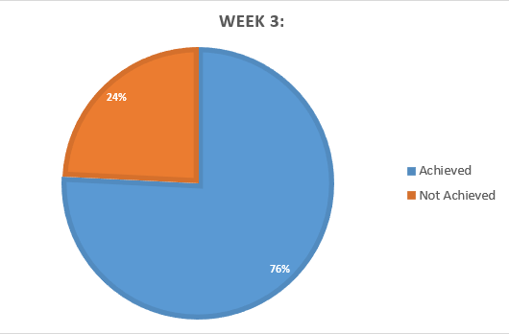

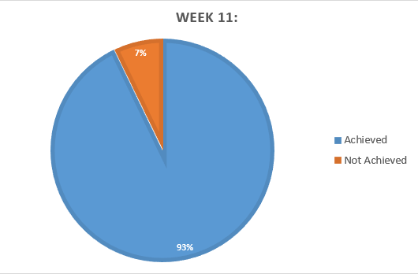


Pilot
Opportunity achievements
Notes:
AL – cup of tea – could do so much but hadn’t moved on

Slide 6
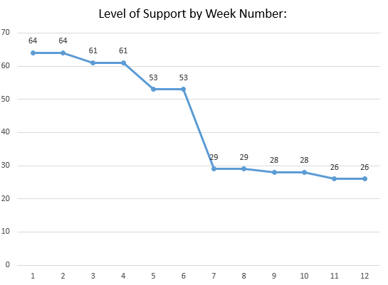
Pilot
Level of Support:
Notes:
Total of all prompt scores – at around 6-7 weeks – drop of prompts / instruct – just reassurance

Slide 7
Culture Change
Leadership / HR
Training
Coaches
Training
All staff
Paperwork
Recording system
Baseline recording
PBS refreshers / Induction
Notes:
From the pilot realised the training alone was not enough for behaviour change of staff
July – December – 400 staff (minus the 75 trained = 325) – put night staff / families on hold
Learnt from Pilot – need leadership on board – push from the top - Presented to leadership / HR / Training depart – re pilot / to be added to all meeting agendas embed in inductions and training
All house managers / teachers trained – approx. 40 coaches
Inset days for all school and college staff -
Care staff more difficult because of shift
Deaf staff – training together
Looked at through lead coaches meetings - More coaches needed as the training is fine but embedding it into the work place better / learning takes place within the service – deputy managers / OT / SALT / HLTA – 20 more
Paperwork – consistency across site - Baseline and file
Refreshers – included in annual refresher
Induction – lead coaches train new staff – including the CEO who started in September – very on board and interested in AS – she has since pushed ELT to have it on their agendas / embed

Slide 8
Update -January 2020
Day with Christine
Learning walk to observe in each area
Lead coaches include OT
Review of tasks – lead coaches to meet with other coaches on a regular basis
Annual reviews / MDT’s agenda
Notes:
Realised needed to expand how people saw AS – doing with not for / whole approach
COVID hit – almost relaunched training/leads etc
Further training included induction training after covid into PBS course

Slide 9
Training
Timetables / White space
Activity | Approximate time to do the activity
Snack / break / supper | 10 minutes (to eat)
Swimming (in the water) | 30 minutes (in water)
Park | 20 minutes
Greeting / tutorial | 20 minutes
Walk round site | 10 minutes
Sensory room | 20 minutes
Television | 30 minutes
computer / ICT session | 20 minutes / 40 minutes?
Gym | 20 minutes
Music | 40 minutes
Outdoor gym | 20 minutes
Activity | Approximate time to do the activity
Snack / break / supper | 10 minutes (to eat)
Swimming (in the water) | 30 minutes (in water)
Park | 20 minutes
Greeting / tutorial | 20 minutes
Walk round site | 10 minutes
Sensory room | 20 minutes
Television | 30 minutes
computer / ICT session | 20 minutes / 40 minutes?
Gym | 20 minutes
Music | 40 minutes
Outdoor gym | 20 minutes
Rebound | 30 minutes
Get changed
Swim
Shower
Get dressed
Notes:
Estimated how long an activity took / added up there usual day / evening – which was less i.e. 7 hour shift filled with 3 hours of tasks / activities

Slide 10
Swimming
Pack shower gel
Pack towel
Pack shampoo
Pack swimwear
Get changed
Swim
Shower
Get dressed
Pack bag
Classroom
Unpack bag
Put towel /swimwear in wash
Put shampoo / shower gel away
Notes:
Look at a full swimming session – changed from a 30 minute session to an hour – involved / participating in tasks

Slide 11
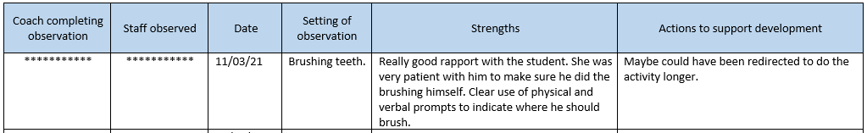
Staff support – learning walks / observations and coaching feedback.

Slide 12
Evidencing the impact
Behaviour watch
Reduction of frequency of behaviour of concern
Reduction of severity of behaviour of concern
Reduction of physical interventions / restrictive practice
Reduction of low level behaviour of concern
Was AS responsible?
Notes:
Many ways to evidence
Our starting point to evidence impact
One way
ABC / scatterplots
Dash board of incidents / PI / reports for individuals / MDT’s
Didn’t tell us if AS was responsible for the reduction

Slide 13
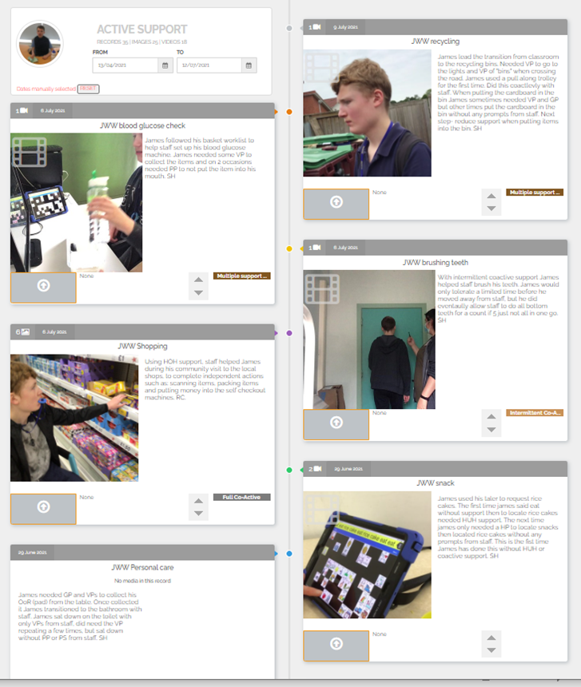
Evidencing the impact
Earwig
An online academic progress tracker which enables support staff to record pictures, videos and text records to evidence progress.
Notes:
Rolling out across site

Slide 14
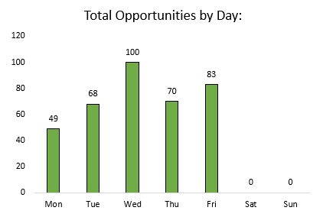
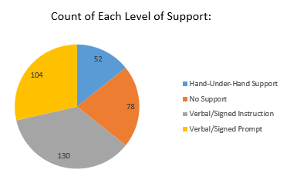
Evidencing the impact
Gathering evidence
  Number of opportunities
  Level of support
  Missed opportunities / white space
  Empowers staff – learner involvement
Notes:
How we evidence the impact
Capture where they start from - Baseline earwig
The information above outlines evidence gathered through the Excel spreadsheet recording system highlighting the number of opportunities to the level of support given. The number of opportunities by day is used to evidence any areas of white space and missed opportunity for development, in reflection of this staff are empowered to seek learner involvement in additional areas of their day.

Slide 15
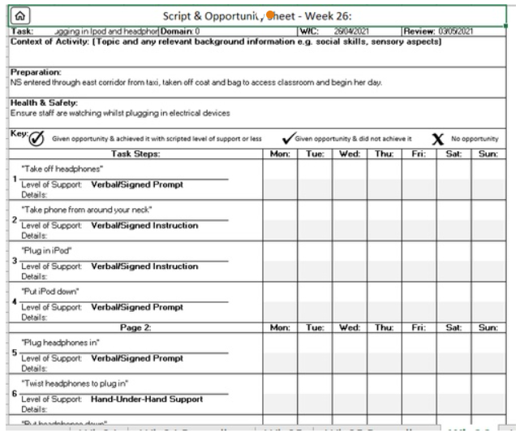
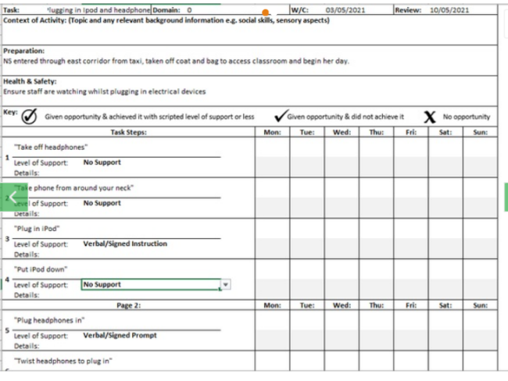
Evidencing the impact
Earwig
Photographic evidence of scripted tasks
Reduction of levels of support
Students ability and confidence
Notes:
Supporting evidence from the Earwig academic system concretes a reduction in levels of support with photographic evidence of scripted task and identified levels of support. This highlights student’s ability and confidence in completing a familiar task with ease, having reduced levels of support from verbal and signed prompt to learner initiation in several areas.

Slide 16
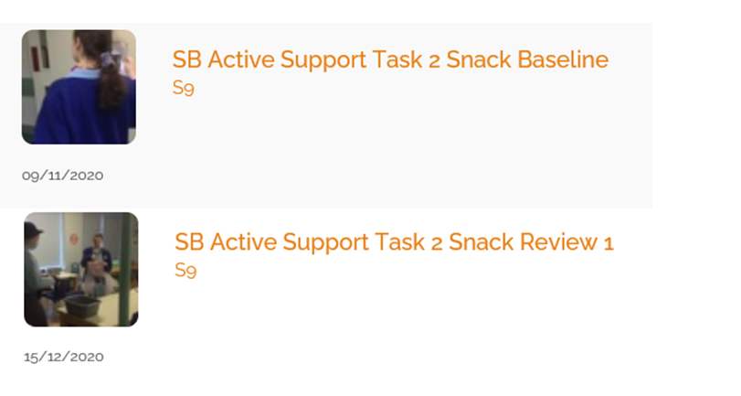
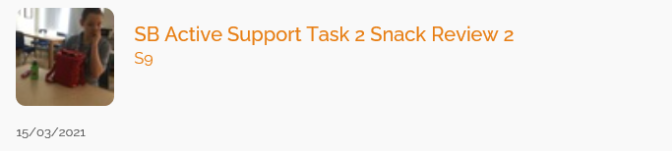
Earwig baseline & reviewing evidence

Slide 17
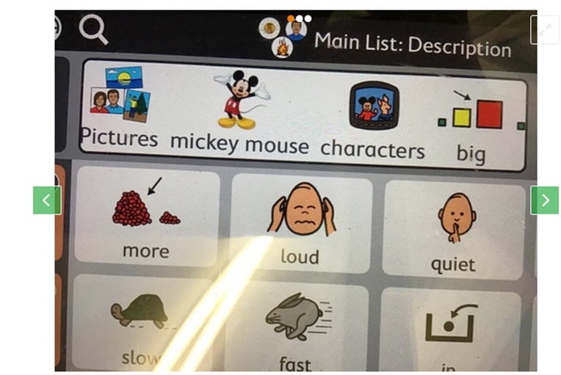
Learner voice: The impact of Active support on learner voice has empowered staff to further promote choice making as a pro-active tool for positive behaviour support. The use of AAC to enable individuals control over their environments has supported the increase in tolerance of triggers.

Slide 18


Data Tool
Training programme
Tracks students wellbeing and engagement
Support staff to work in an instinctive way
State of arousal
Notes:
To develop a training programme and data tool that helps to track student wellbeing and engagement with learning, while supporting staff to work in an instinctive way and to help students to understand their wellbeing and state of arousal.

Slide 19

Engagement
When a child is immersed in an activity which they find engaging they can be described as being in a state of “flow”. They feel a positive emotional response arising from their ability to make progress, or move forward with something that they see as important or meaningful.
Increased independence
‘just’ happens, when we recognise and utilise, the wide range of incidental, as well as planned activities, which occur throughout the day.
Some of the best learning often happens when we have not planned it and we do ‘with’ not ‘for’!

Slide 20
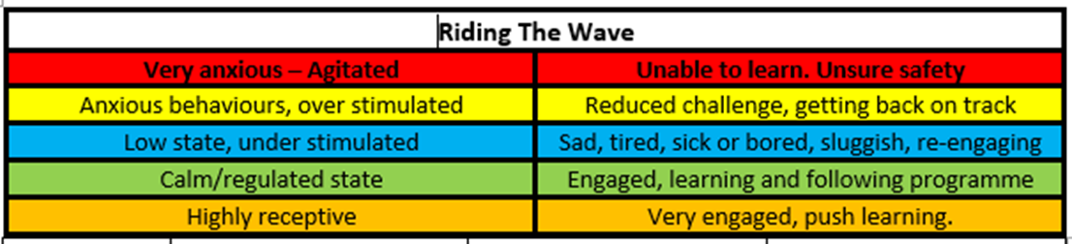
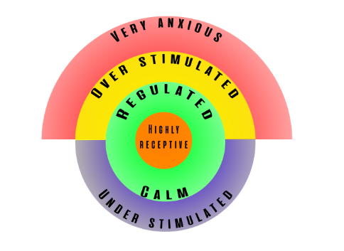
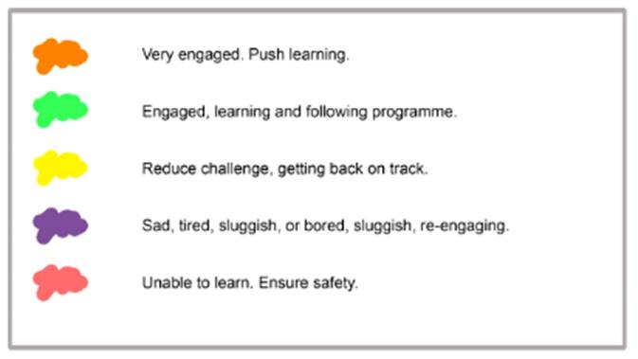
Receptivity to learning varies all the time

Slide 21
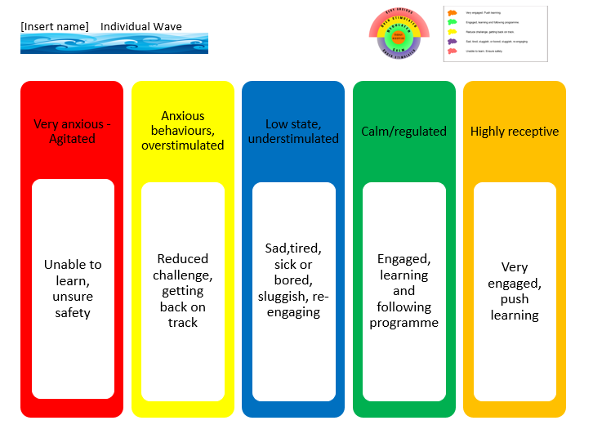

Slide 22
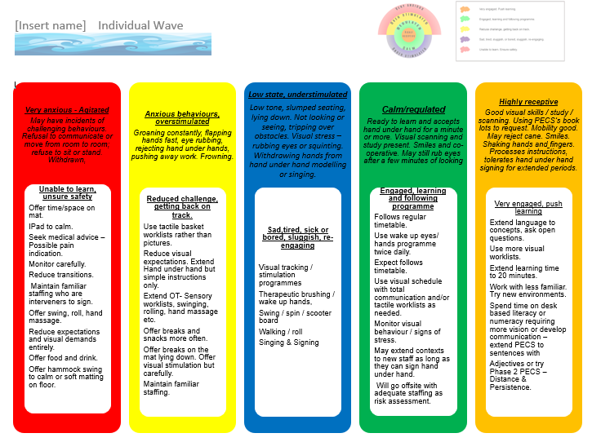

Slide 23
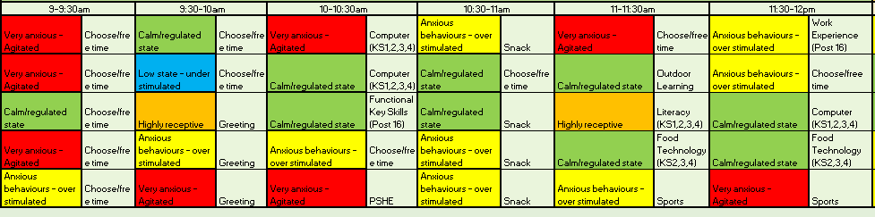
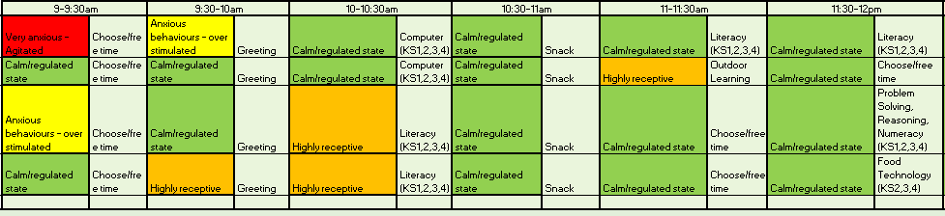
Riding the wave
Notes:
Links to AS – so can see if AS has had an impact on the C/YP

Slide 24
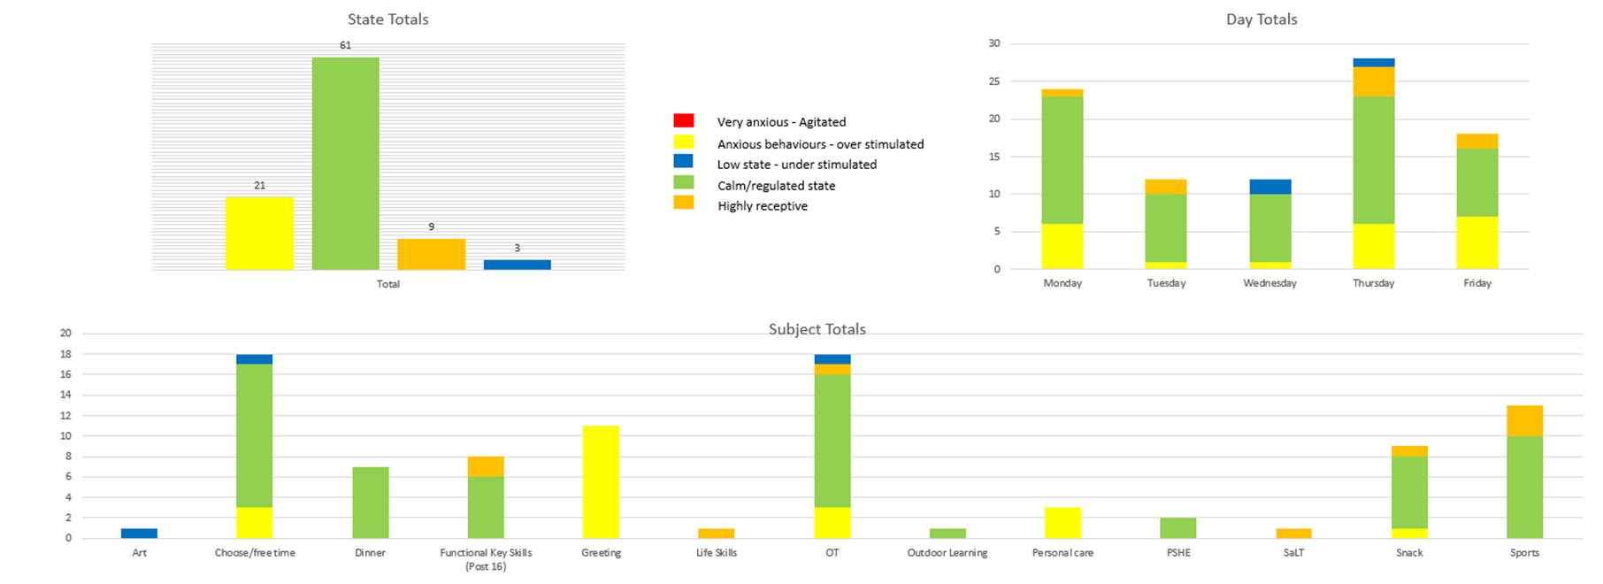

Slide 25
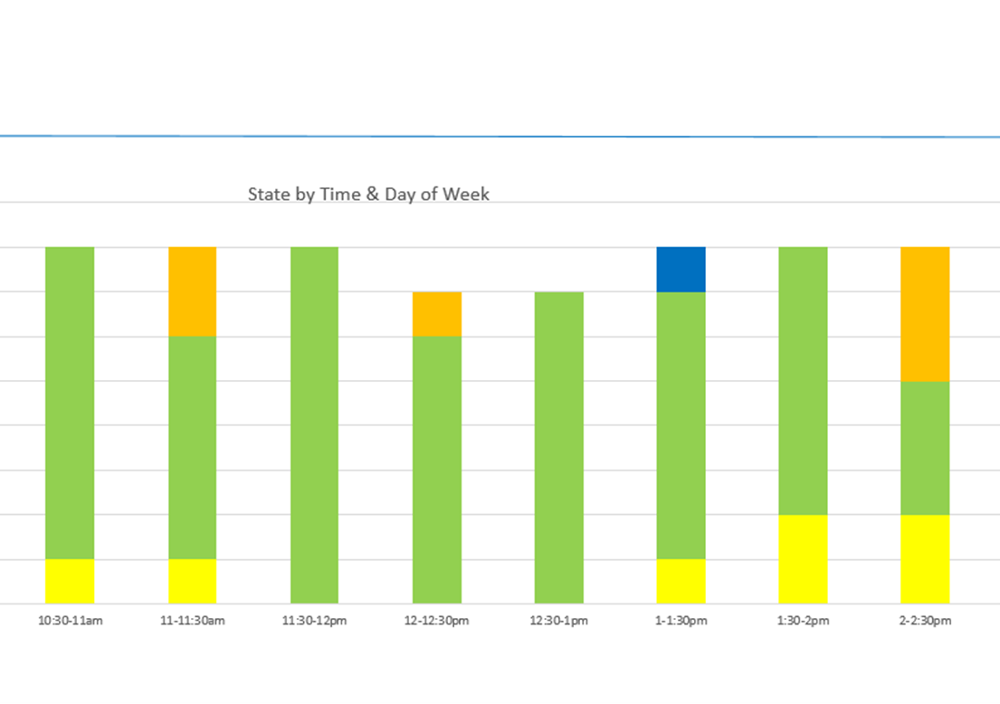
Informs the curriculum
Identifies improvements / engagement

Slide 26
CASE STUDY
18 year old young lady diagnosed with Crie du chat, non verbal
Cookery
Pre- script – presented as disinterested / fingers in the beans / incidents of behaviour daily
Riding the waves – (RED)
Script in place – using talker / involved / empowered
    No incidents in cookery
    Maintained over time
    Riding the waves (GOLD)
    Generalised skill at home

Slide 27
Behaviour of concern and Active support
Data analysis
2019-20 / 2020-21
Introduction of Active Support
Clear decrease of incidents
    11am – 1pm
    Days of the week
    Internal factor – hunger
Reduction of severity

Slide 28
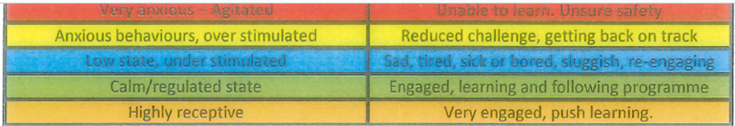
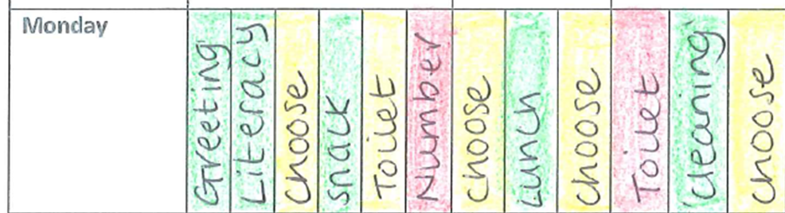
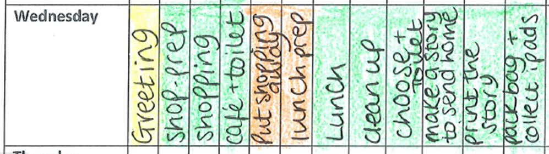
Active Support and Riding the Waves
Notes:
Before AS -too much ‘free time’ led to an increase in behaviour when demands were placed upon them and learning was disjointed.
After AS – student more involved in functional learning and creates a story on the PC of what has happened at school to share at home. Student has additional responsibility of collecting iPads from their peers at the end of the day.

Slide 29
CASE STUDY
14 year old young man diagnosed with ASC, Deaf and non-verbal
Cookery
Pre-script
  Behaviour of concern presented as running into the room, grabbing cooking oil / pouring onto himself
  Refused to clean utensils / tables
  Riding the waves (RED)
Script in place
  Script in book with finish pouch
  Riding the waves (GOLD)
Transferring skills
  Scripts for other areas
  Completes all script / tasks
  Follows scripts at home
Notes:
Staff now see benefit of Active Support and scripts – transferring it to other areas

Slide 30
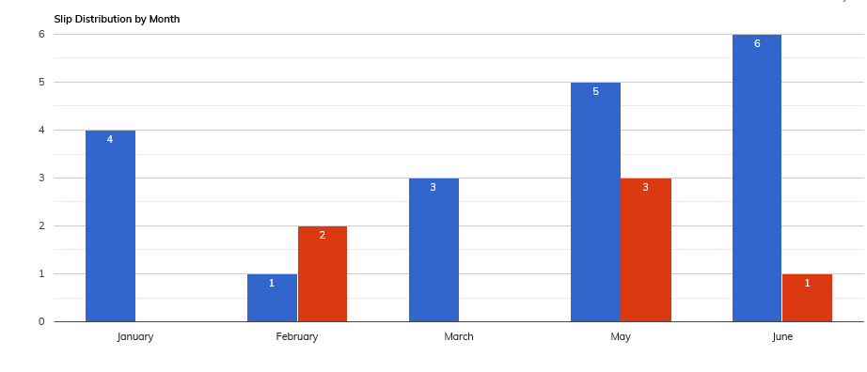
Behaviour of concern and Active support
Data analysis
2019-20 / 2020-21
Scripts in place for many activities / tasks
Reduction in Art / baking / free time
Shopping etc.

Slide 31

Holistic approach
Empowering staff
Observations
Learning walks
Learner voice
Earwig
Engagement
Reduction of frequency / severity of incidents
Riding the waves

