Slide 1
Active Support - App
An update

Slide 2
Overview
Outcomes of Active Support/AS-App roll-out so far
What’s planned for App Version II
North Wales Project

Slide 3

Introduction
An Active Support App has been developed by an independent provider organisation in north-west England
The AS-App uses a digital platform to:
provide an efficient alternative to the current paper based systems
complement and enhance Active Support implementation

Slide 4
Introduction
The Active Support App was piloted as part of a systematic, multi-component Active Support roll-out across 27 supported living homes
Outcomes will be presented today for eight of the homes, for which impact has been fully evaluated

Slide 5
Method

Slide 6

Method – who was involved?
Twenty-two people (13 men and 9 women)
Diagnoses ranging from mild to profound intellectual disabilities
Six people were also diagnosed with Autistic Spectrum conditions
Three had formally diagnosed mental health conditions

Slide 7
Method – who was involved?
Forty-four staff from across the eight participating households
Average length of service – 2.4 years (range 1yr – 6yrs)

Slide 8
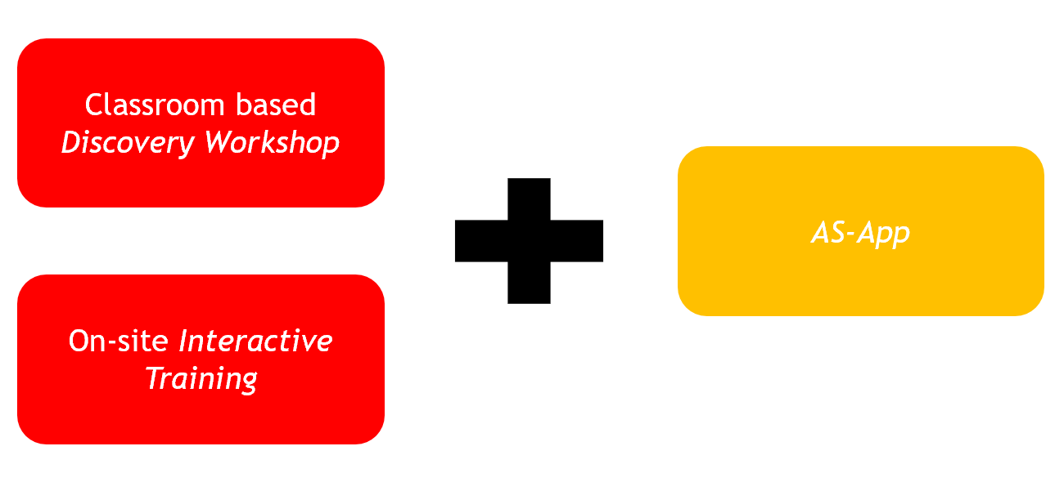
Method – what did we do?
Active Support Intervention (house by house)
Notes:
.

Slide 9

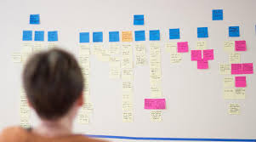
Discovery Workshop
One day workshop for staff team and house manager
Concepts around Active Support
Mapping of personal daily routines – “anchor activities”
Task analyses of personal and household activities – “scripts and customs”
Listing of “incidental” activities

Slide 10
On-site Interactive Training
2 hour on-the-job Interactive Training session bespoke to each staff member (Toogood, 2010) within 10 days of the Discovery Workshop
Experienced trainer and house manager conducted sessions: providing coaching and collecting data
All people resident in the houses participated in at least one Interactive Training session

Slide 11
AS-App
The Active Support App accounts were created for each house using information generated at the Discovery Workshop
Staff were trained in using the Active Support App
The Active Support App was deployed in each of the houses
Ongoing involvement and support experienced Active Support practitioners for maintenance

Slide 12

Method – Pre and Post measures
Prior to intervention and 6 weeks post intervention, managers and behaviour analysts conducted:
1. Direct observations to measure:
  Staff engagement
  Client engagement
  Challenging behaviour
*Including Interobserver agreement
2. Active Support Measure (Mansell and Elliot, 1996)
  Quality of Support

Slide 13
Outcomes

Slide 17
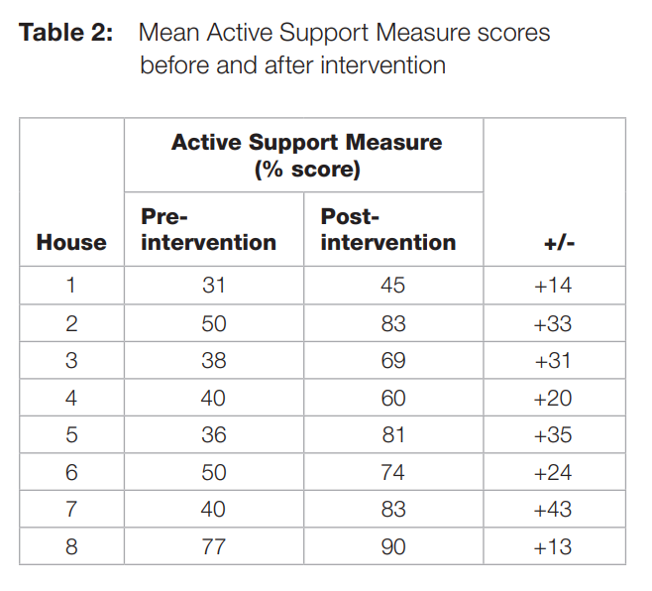
Active Support Measure

Slide 18
Discussion
Multi-component intervention was delivered in a compact time frame for each house:
The Active Support App was introduced and aimed to assist with:
person centred activity planning
deployment of staff support
ongoing monitoring of individual’s engagement
improving consistency in support via personal routines and customs

Slide 19
Discussion
We believe that the AS-App contributed to the adoption of Active Support by staff
We also feel that the AS-App fulfilled the planning and monitoring purposes for which it was designed.
Finally, we feel that the AS-App plays its part in increasing opportunities, smoothing transitions between activities and improving consistency between staff – all key goals of Active Support.

Slide 20
Enhancements for AS-App VII

Slide 21
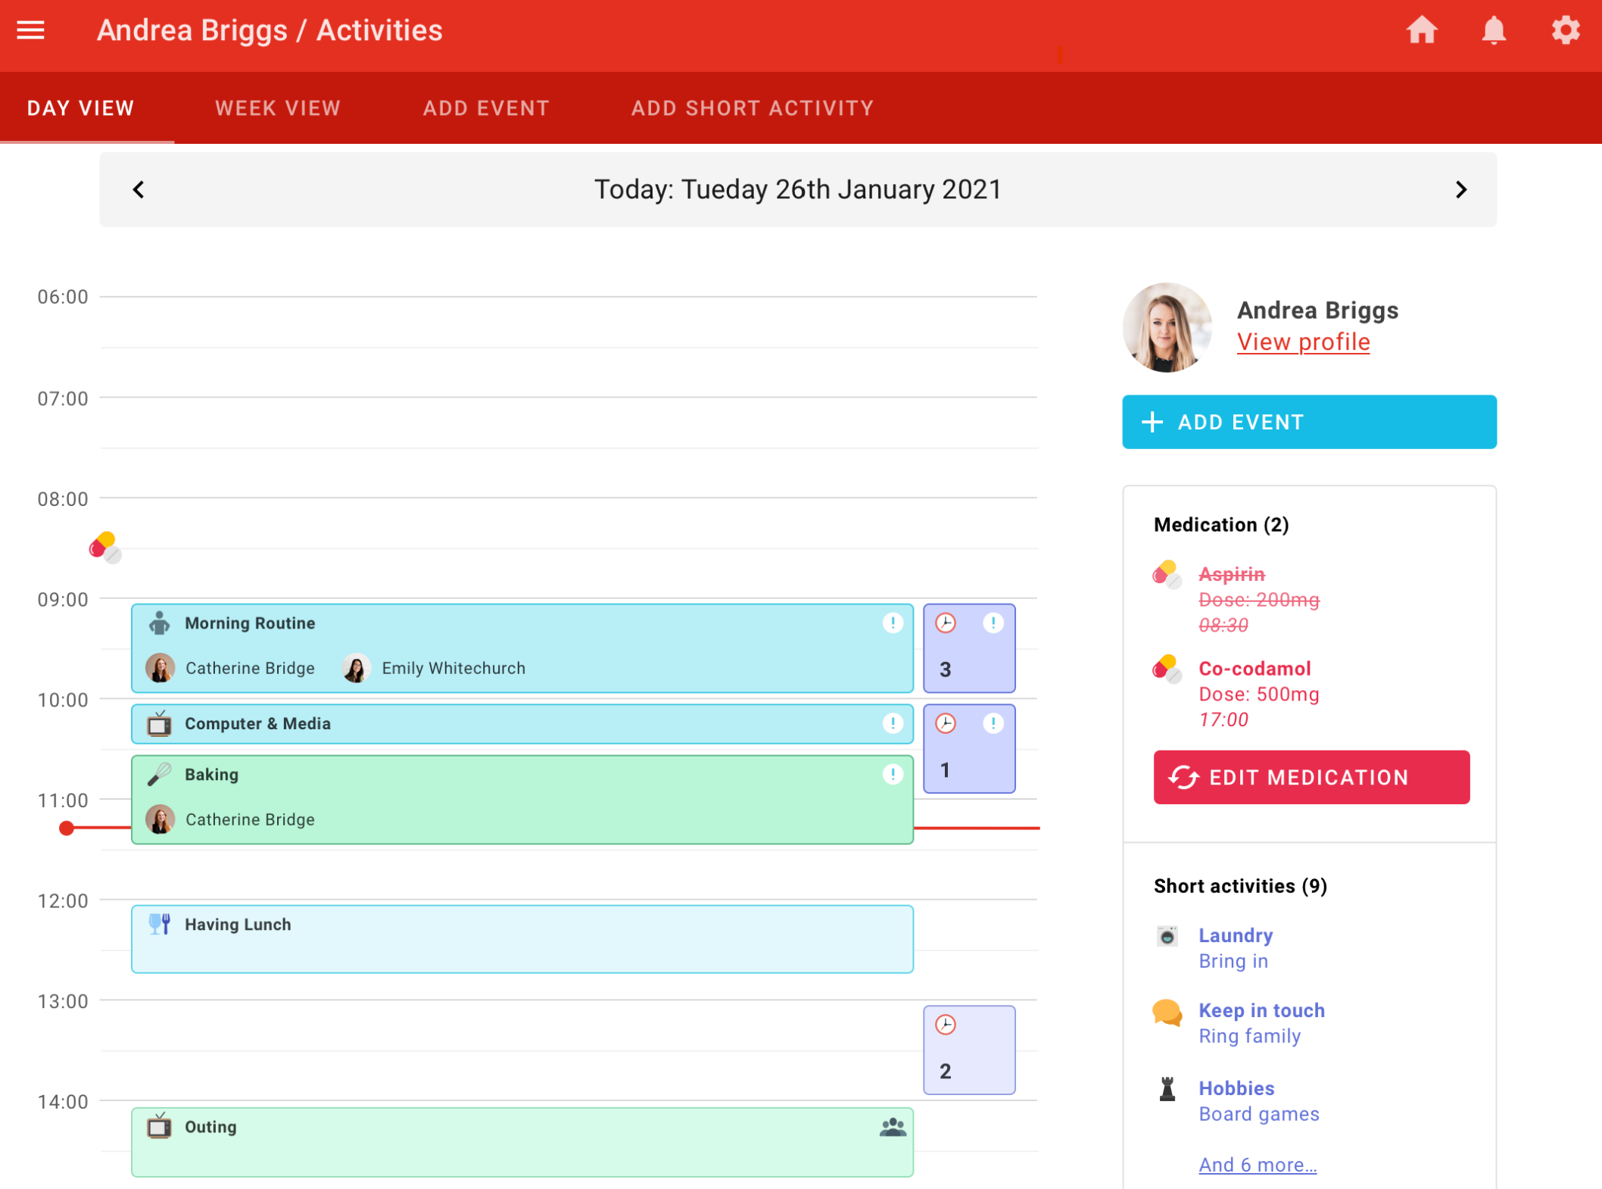
Single Person View

Slide 22
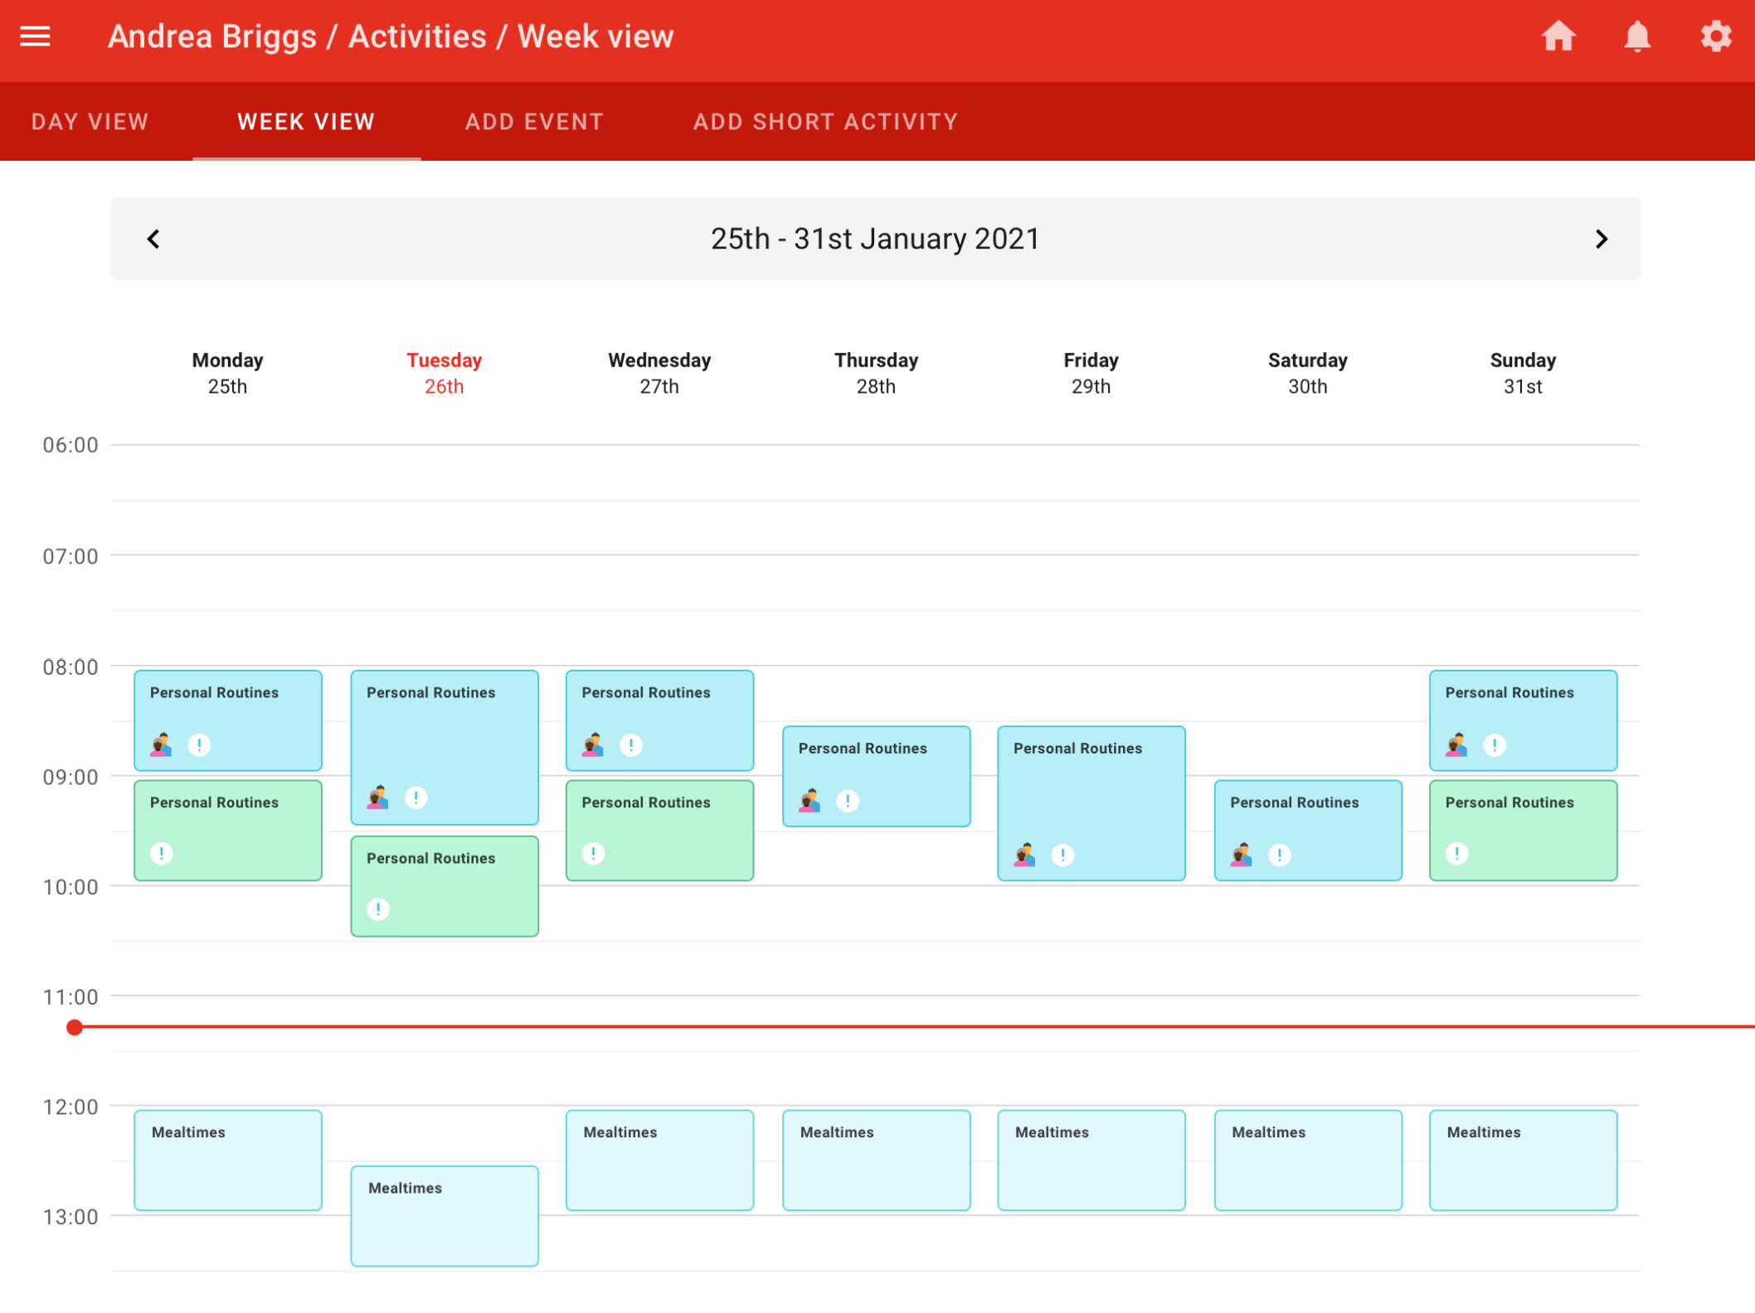
Weekly View
Notes:
.

Slide 23
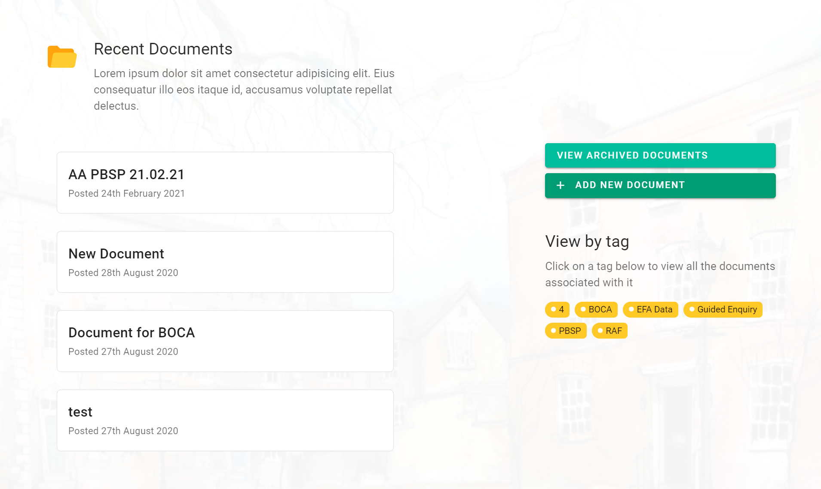
Upload Documents
Incident Reporting
Daily Logs
Body Maps

Slide 24
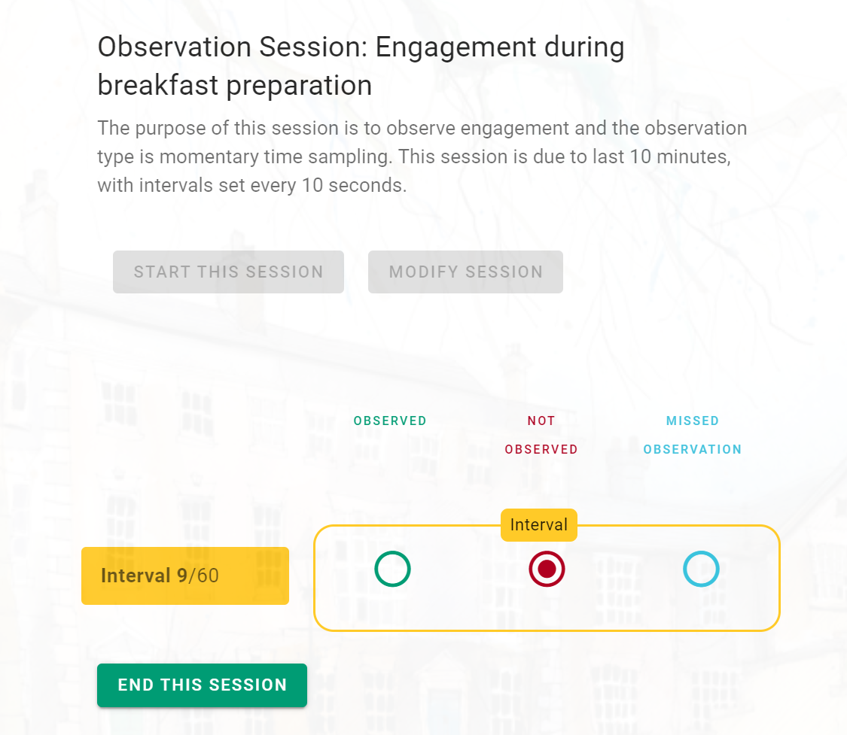
Behavioural observations
Notes:
.

Slide 25
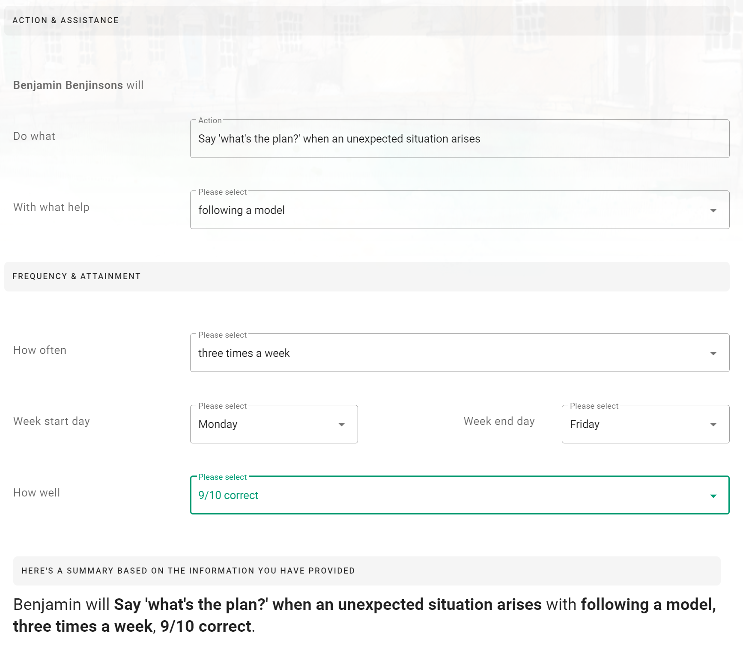
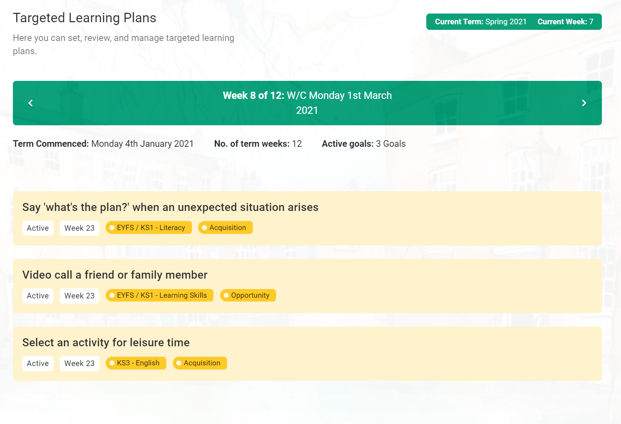
Plan Targeted Learning Goals

Slide 26
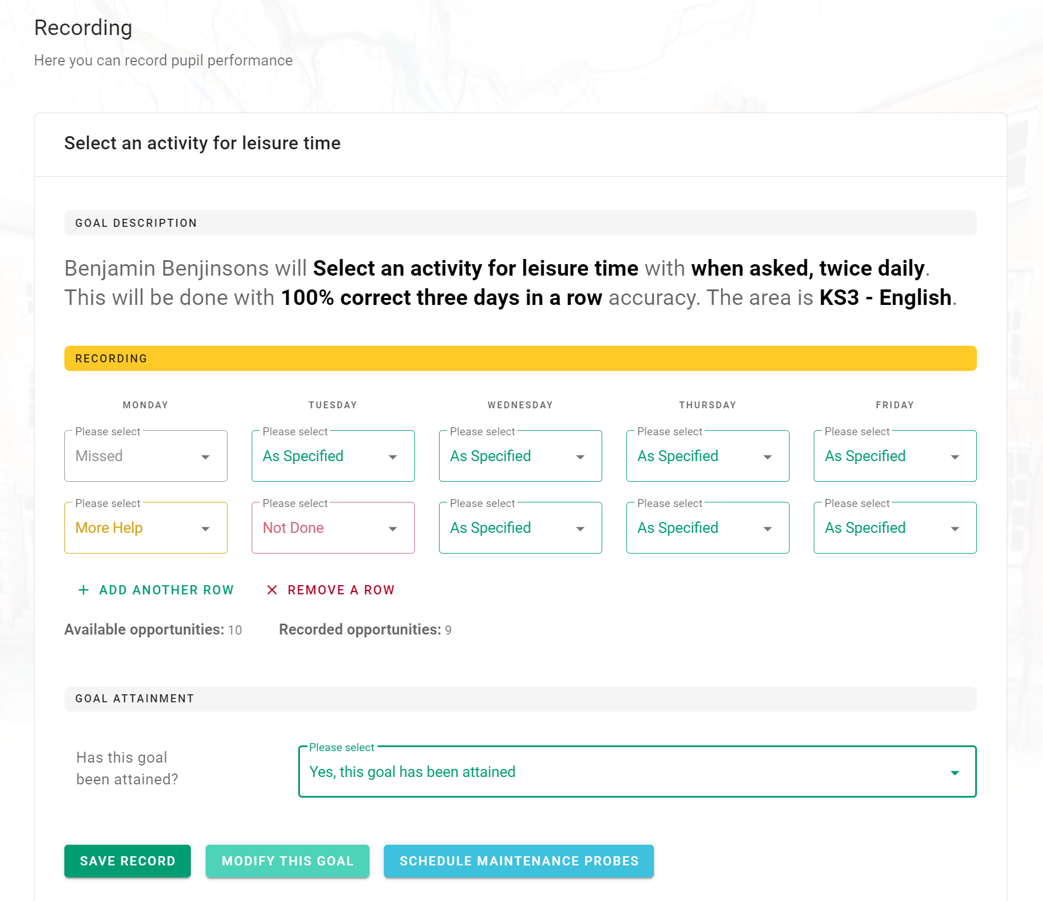
Record Targeted Learning Goals

Slide 27
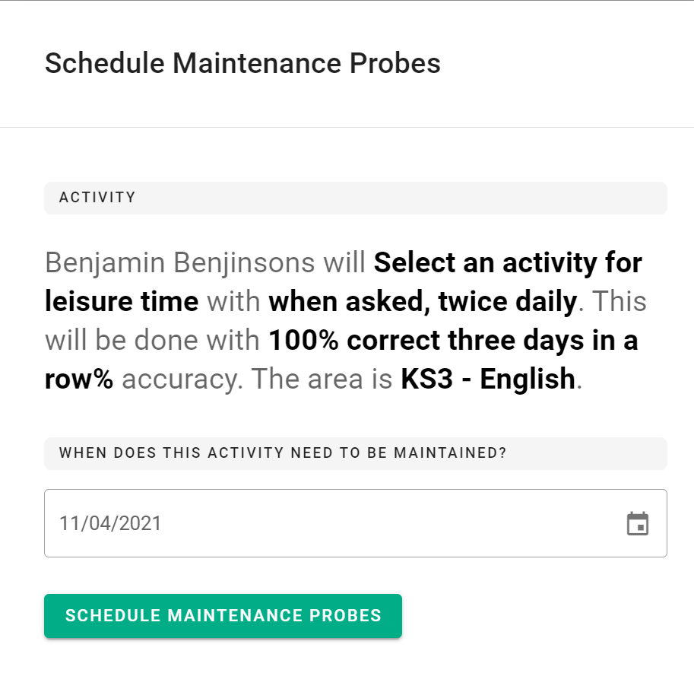
Schedule Maintenance Probes

Slide 28
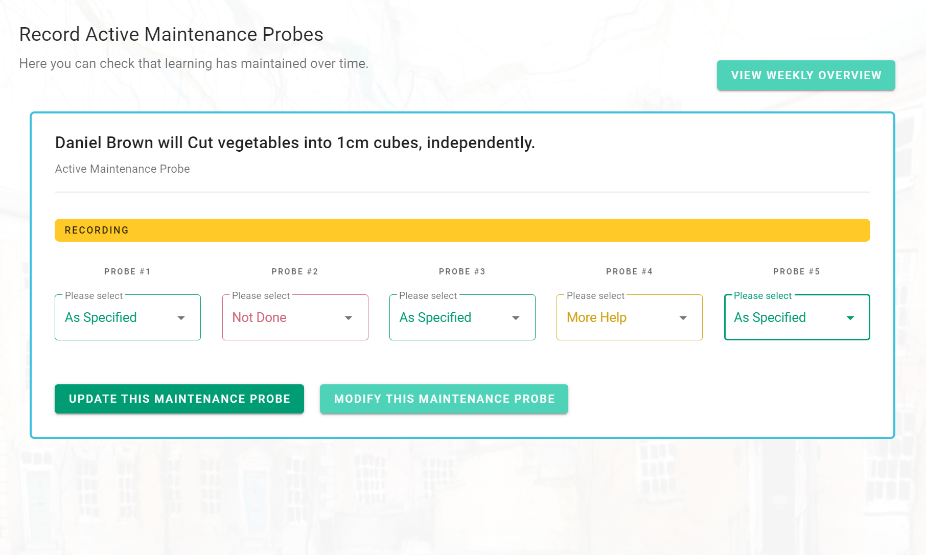
Record Maintenance Probes

Slide 29
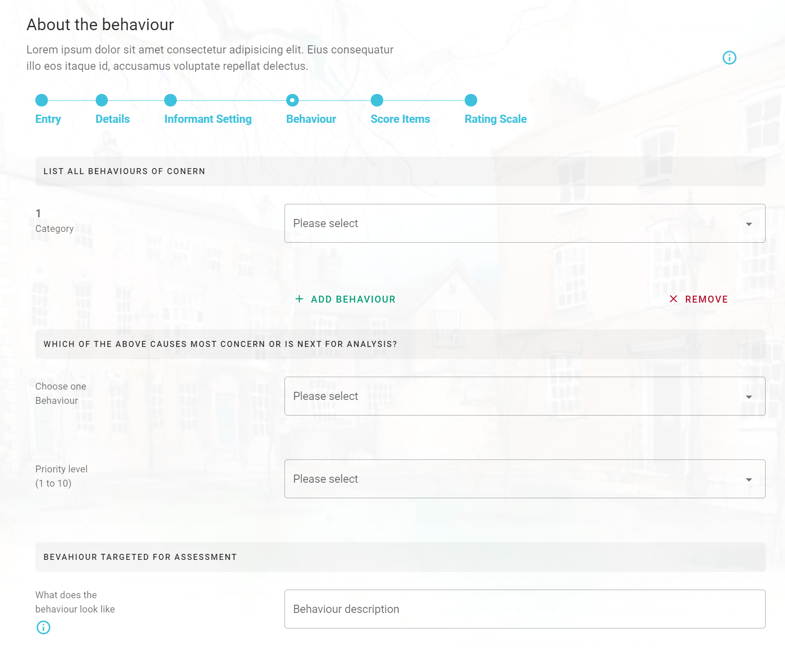
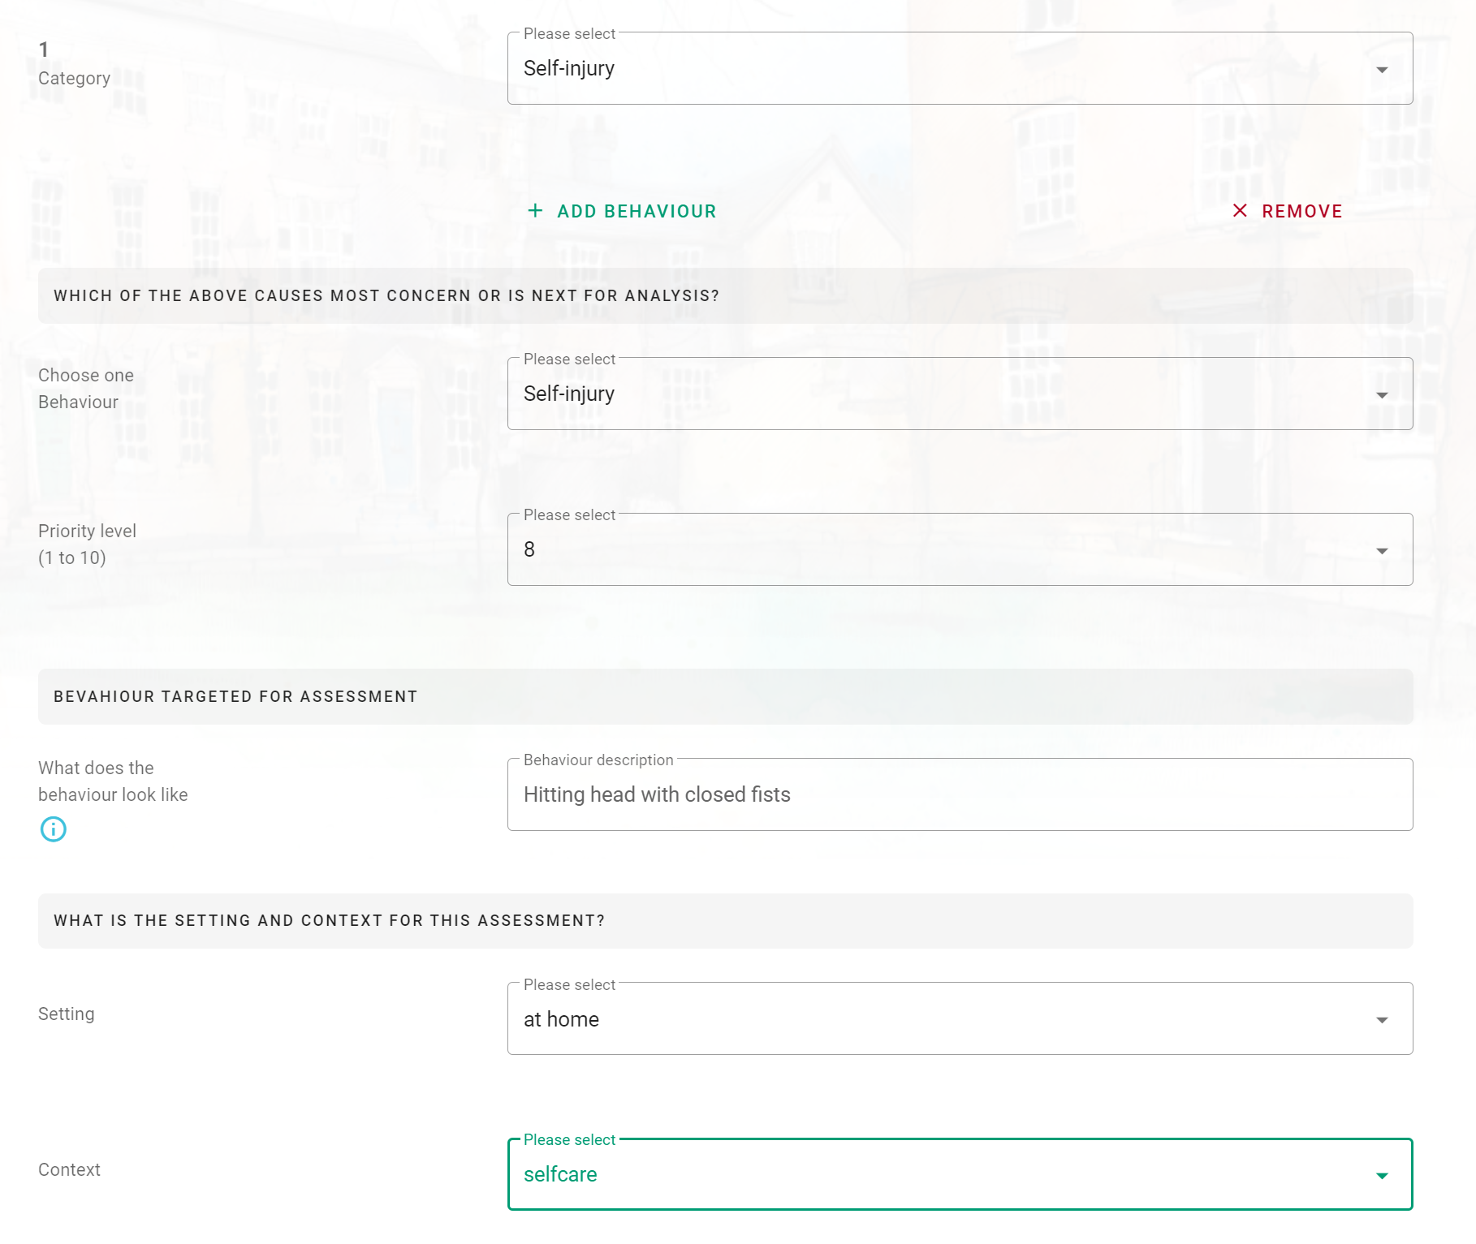
Rapid Assessment of Function (RAF)

Slide 30
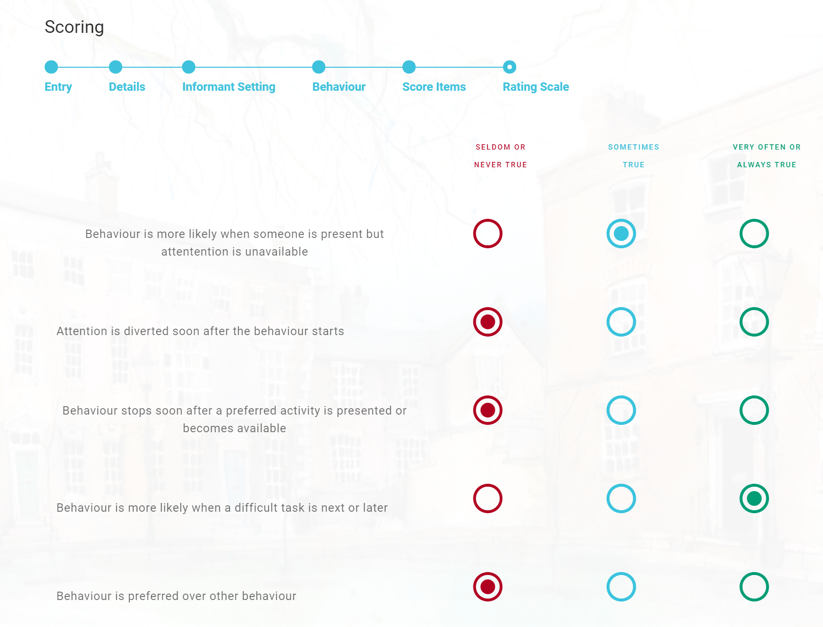
Rapid Assessment of Function

Slide 31
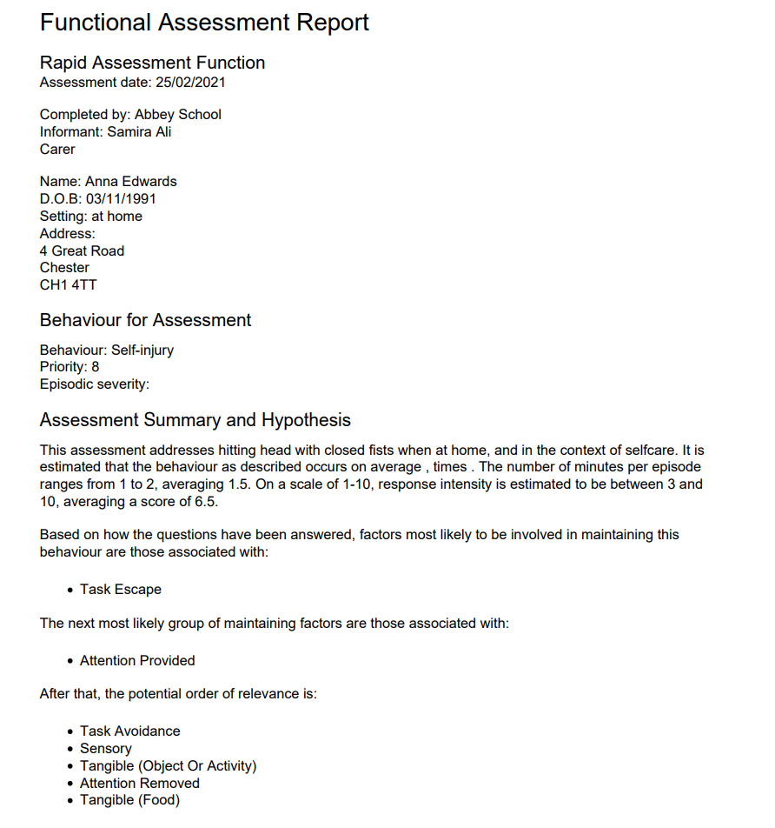
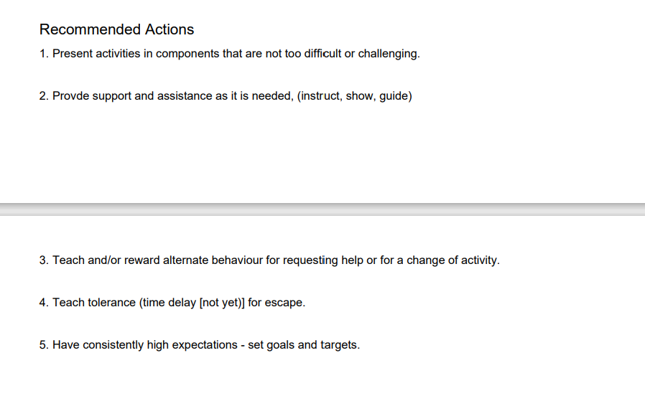

Slide 32
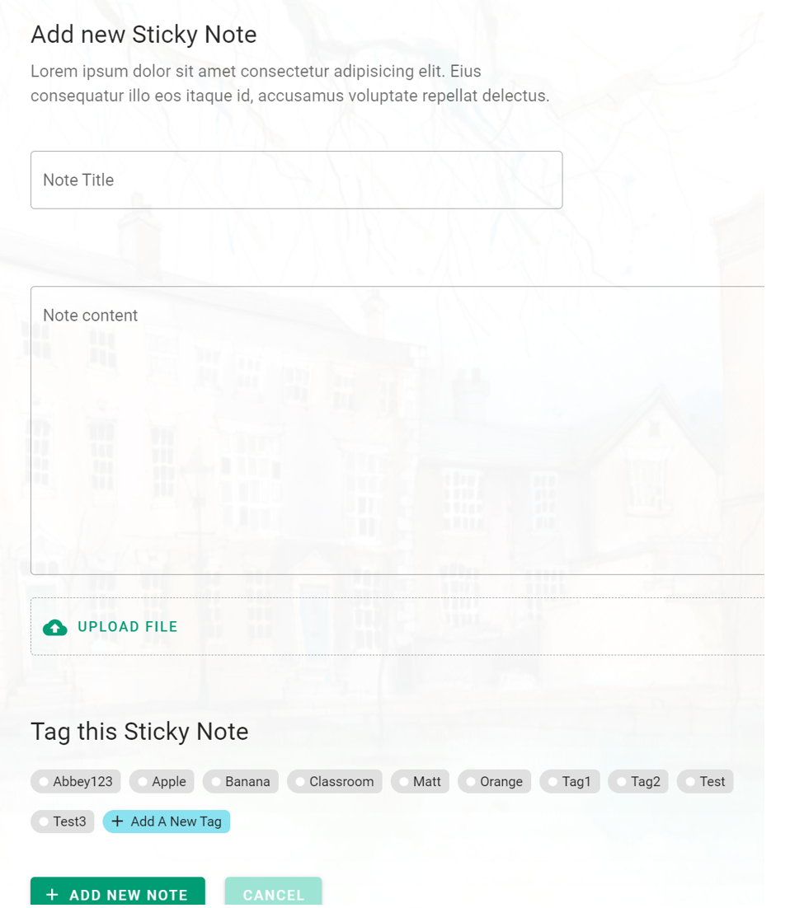
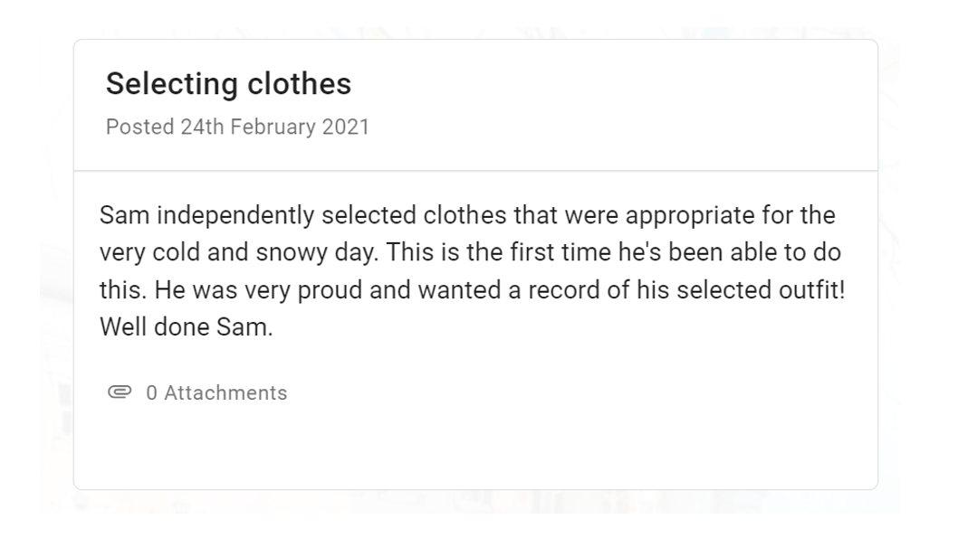

Capturing “Wow” Moments

Slide 33
North Wales Together: Seamless Services for People with Learning Disabilities

Slide 34
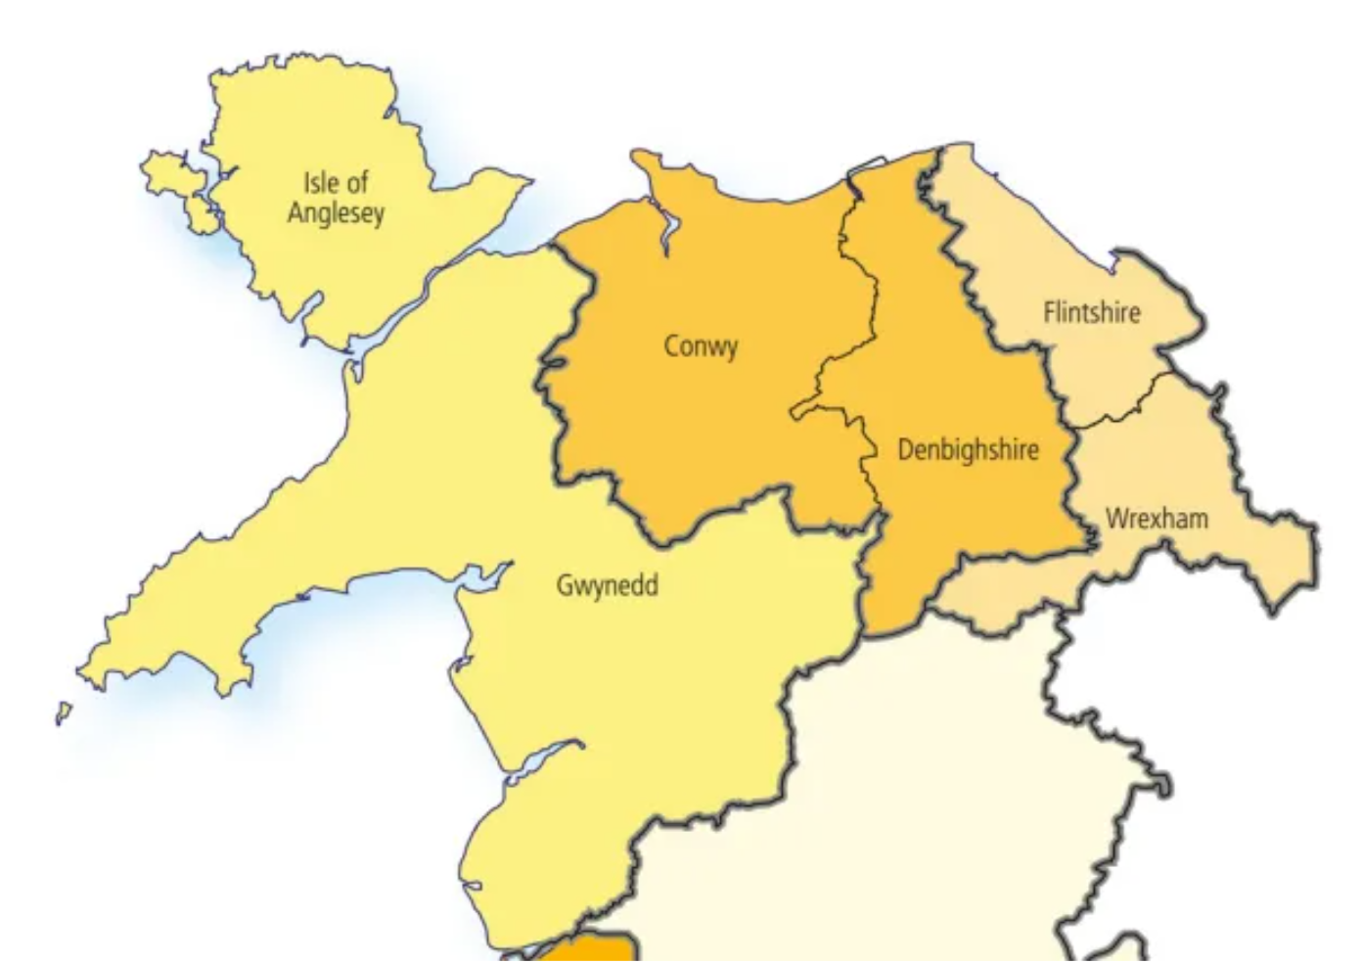
Background
In line with the North Wales Transformation Programme, a collaboration has been formed
An Active Support and AS-App package to be implemented across the North Wales region

Slide 35

Pilot Phase
Pilot phase is in progress with 2 houses

Slide 36
Method – who is involved in the pilot?
Across the two houses:
Five people (4 men and 1 woman)
Staff teams including service managers and senior support workers

Slide 37
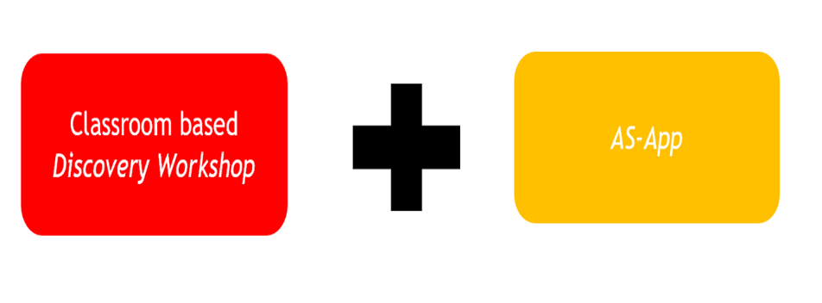
Method – what are we doing?
Pilot Phase – Active Support + App Intervention

Slide 38
Method – Pre and Post measures
Prior to intervention and 6 weeks post intervention, managers conduct:
Active Support Measure (Mansell and Elliot, 1996)

Slide 39
Outcomes
House | Active Support Measure (% score) |  | +/- (% score)
 | Pre -intervention | Post-intervention
NW1 | 47 | 76 | + 29
NW2 | 85

Slide 40
What do staff think of the AS-App?
“I had very little understanding of Active Support since I have only been employed in the sector recently. The app has made me understand more about what Active Support is all about and why we do it, the routines/scripts have helped me get to know the routines of the tenants much easier, and when I start my shift and looking on the app, it is much easier to know what I’m supposed to do for the day/evening, by following the tasks and times. If I’m unsure how to support the tenants in specific tasks, the scripts and routines have helped me also”.
“A very good example where the app has been successful: one tenant was supported to hoover on daily basis. One particular day, we witnessed the tenant hoovering the games room, without prompt or ask. He went to get the hoover himself and cleaned the room without any kind of support. This showed by prompting the tenant on a daily basis, he learned how to hoover without any kind support”.
“There have been occasions where it has been difficult to introduce tasks with one of the tenants as on occasion he may show challenging behaviour, but with staff consistency and working in the same way through using the app, we have managed to introduce more activities and he has been showing less challenging behaviour when doing the tasks. (Tasks such as hoovering and preparing meals)”.

Slide 41
What do staff think of the AS-App?
“I find the app has made us aware of how important Active Support is for the tenants in independent living and has given us a mentality of thinking differently on how we can improve as a support worker. For example - if there a tasks needed doing, we let the tenants participate and we support if needed with the steps. I will always leave the tasks for the tenants to participate, before I would have do some of the tasks myself”.
Active support (which was already excellent) has been ‘reinforced’ thanks to the app. Tenants are doing a lot more in the house and genuinely are enjoying the extra chores that have been added into their daily living and wellbeing. (Most of the time). Staff have also benefited from the app because they seem to have a more positive outlook for the day ahead.
What we have noticed more than anything some of the tenants are doing tasks/chores without being prompted by staff, which is absolutely great, They are aware of certain things that need to be done and will just ‘get on with it’ obviously other things still need prompts etc but I feel this is always a step in the right direction.

Slide 42
What do staff think of the AS-App?
“It would be beneficial to add a section to each tenant where we can write a report on how individuals are feeling or any behaviours to explain a lack of activities that day. I think it will be good for the future if we can use this app instead of writing report books, this will save us on doing paperwork and save us time to support the tenants further through Active Support”.
“I think this could be beneficial in the future to reduce paperwork such as report books, active support files etc. By reducing paperwork, more time for staff to support the tenants in active support”.

Slide 43
Next Steps………….
Roll-out of Active Support and AS-App across all NW counties:
Local authority, health and third sector led providers

Slide 44

Next steps
If you are involved with services that you feel would like to be involved in the roll-out programme, please contact:
Steve Brown - steve.brown@flintshire.gov.uk

Slide 45
Thank you for listening!
Questions?
References
Mansell, J and Elliot, T E (1996) Active Support Measure. Canterbury: Tizard Centre
Toogood, S (2010) Interactive Training: Supporting People with Severe and Profound Intellectual Disability in Meaningful Activity. Brighton: Pier Publishing Company
Toogood, S, McLennan, K, Welch, C, McGolpin, J and Murvai, E (2020) Active Support in the digital age: Practice Paper. International Journal of Positive Behavioural Support, Volume 10, (2), 30-40

